Slide 1
Fiber Bundle Selection And Scalar Measurement
Fan Zhang
The University of Sydney, Australia
Brigham and Women’s Hospital, USA
fzhang@bwh.harvard.edu
Notes:
Hello everyone, my name is Fan from BWH. I am going to present a tutorial about fiber bundle selection and scalar measurement. It is about how to do further processing after we obtain tractography.

Slide 2
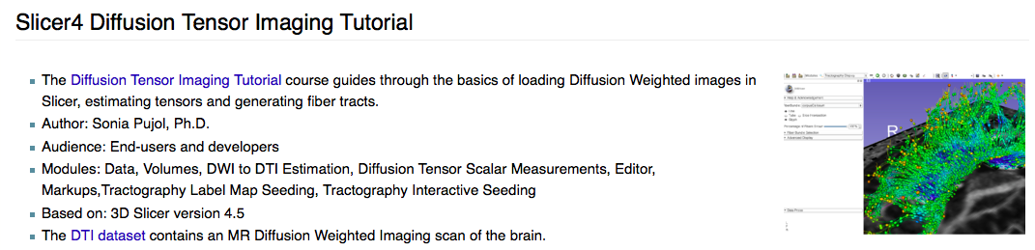
Pre-requisite
This tutorial is a follow-up tutorial of the “Diffusion Tensor Imaging Tutorial” by Sonia Pujol, PhD. Please go through this ahead, which is available at:
https://www.slicer.org/slicerWiki/index.php/Documentation/4.5/Training#Slicer4_Diffusion_Tensor_Imaging_Tutorial
Notes:
This is a follow-up tutorial of the DTI tutorial by Sonia. A brief introduction, the DTI tutorial introduces how to do tensor estimation to obtain DTI, how to calculate the scalar tensor measurement such as FA, Trace from DTI, and how to do tractography.

Slide 3
Learning Objectives
Following this tutorial, you’ll be able to:
select fiber bundles passing through region(s) of interest, and
calculate scalar measurements (such as FA and trace) from the fiber bundles.
Notes:
In this tutorial, I’ll introduce how to do some after-tractography processing. The first one is how to select fiber tracts passing through a region of interest. For example, given a label map of CC, we want to see the fibers passing through the CC. The second one is to calculate scalar measurements from the the selected fiber bundles. Like, how to compute the mean FA from the tracts of the CC.

Slide 4
Tutorial Outline
Editing multiple labels
Whole brain tractography
Fiber bundle selection
Fiber bundle scalar measurements
Notes:
For the next part, I’ll show a step-by-step processing of doing the stuff that I just mentioned.
First, I’ll show how to draw several labels from CC, which give multiple regions of interest of entire CC, anterior part, the middle part and the posterior part of CC.
Then, I’ll show how to do whole brain tractography that includes all fibers obtained by tracing algorithm of the brain.
After that, we will conduct the fiber bundle selection given the multiple labels and whole brain tractography.
After getting the fiber bundles from the regions of interest, I’ll show how to extract scalar measurements from them.

Slide 5
Tutorial Software
The tutorial uses the 3DSlicer (Version 4.5.0-1 Stable Release) software available at
http://download.slicer.org
Data available at
http://www.na-mic.org/Wiki/index.php/FiberBundleSelectionAndScalarMeasurement_TutorialContestWinter2016
Disclaimer
It is the responsibility of the user of 3DSlicer to comply with both the terms of the license and with the applicable laws, regulations and rules. Slicer is a tool for research, and is not FDA approved.

Slide 6
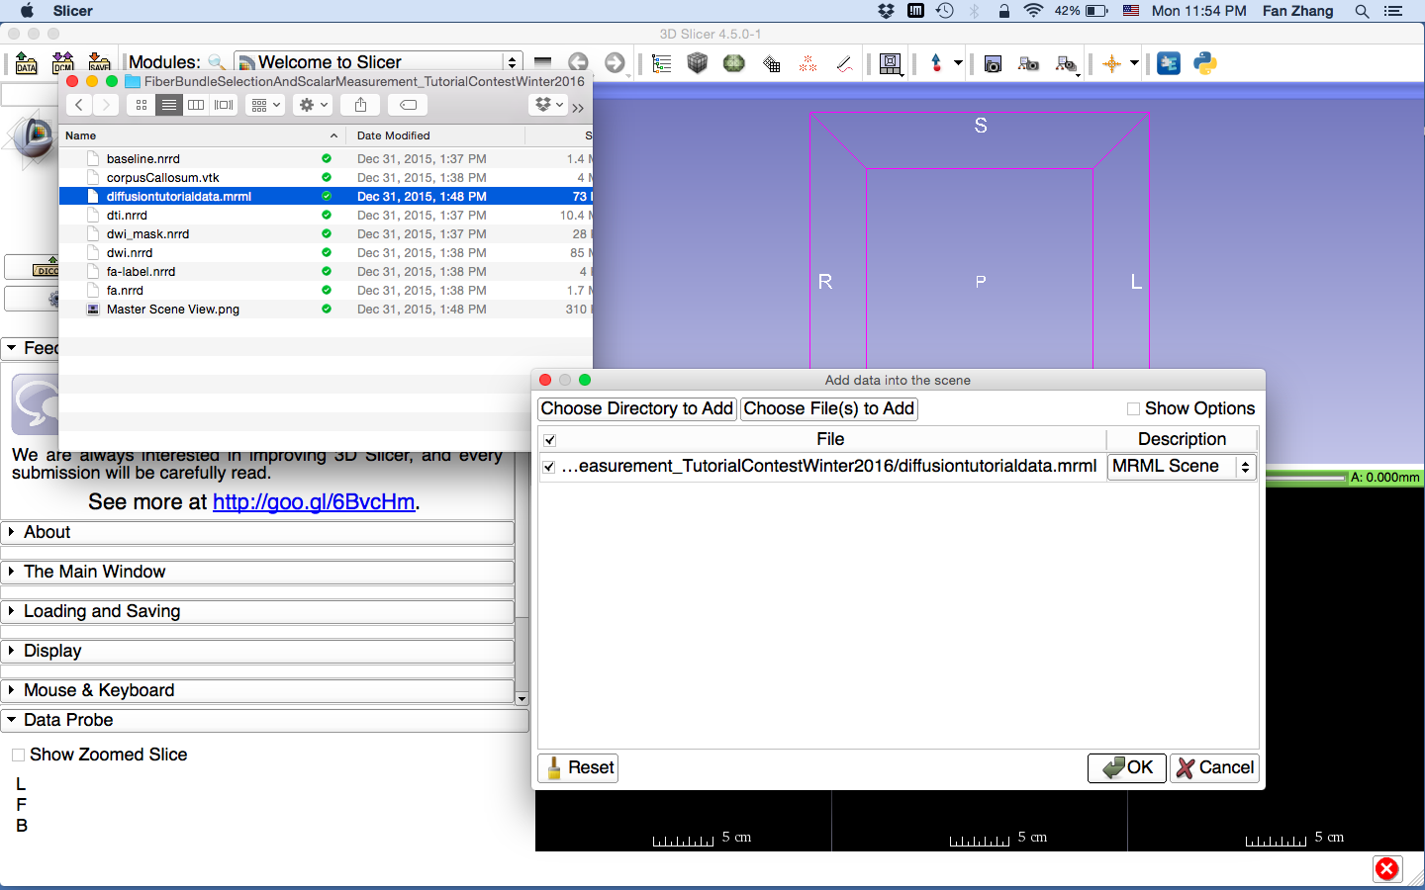
Load MRML Data
Unzip the sample data
Within the unzipped folder, locate the MRML Scene file: diffusiontutorialdata.mrml
Drag and drop the file onto the viewer of the Slicer application
Click OK to load the dataset to Slicer
Notes:
First, let’s load a mrml file that includes the data we need in this tutorial.

Slide 7
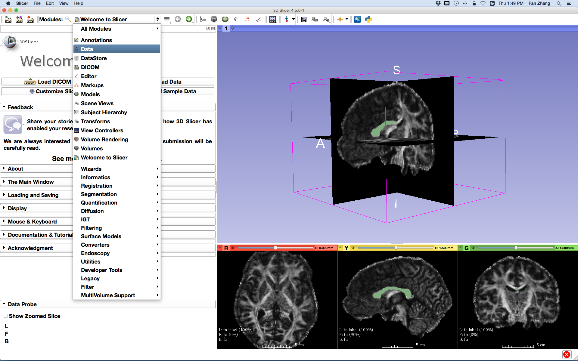
Load MRML Data
Click on the Modules menu and select the module Data
Notes:
If you go to the Data module, you will see the data just loaded

Slide 8
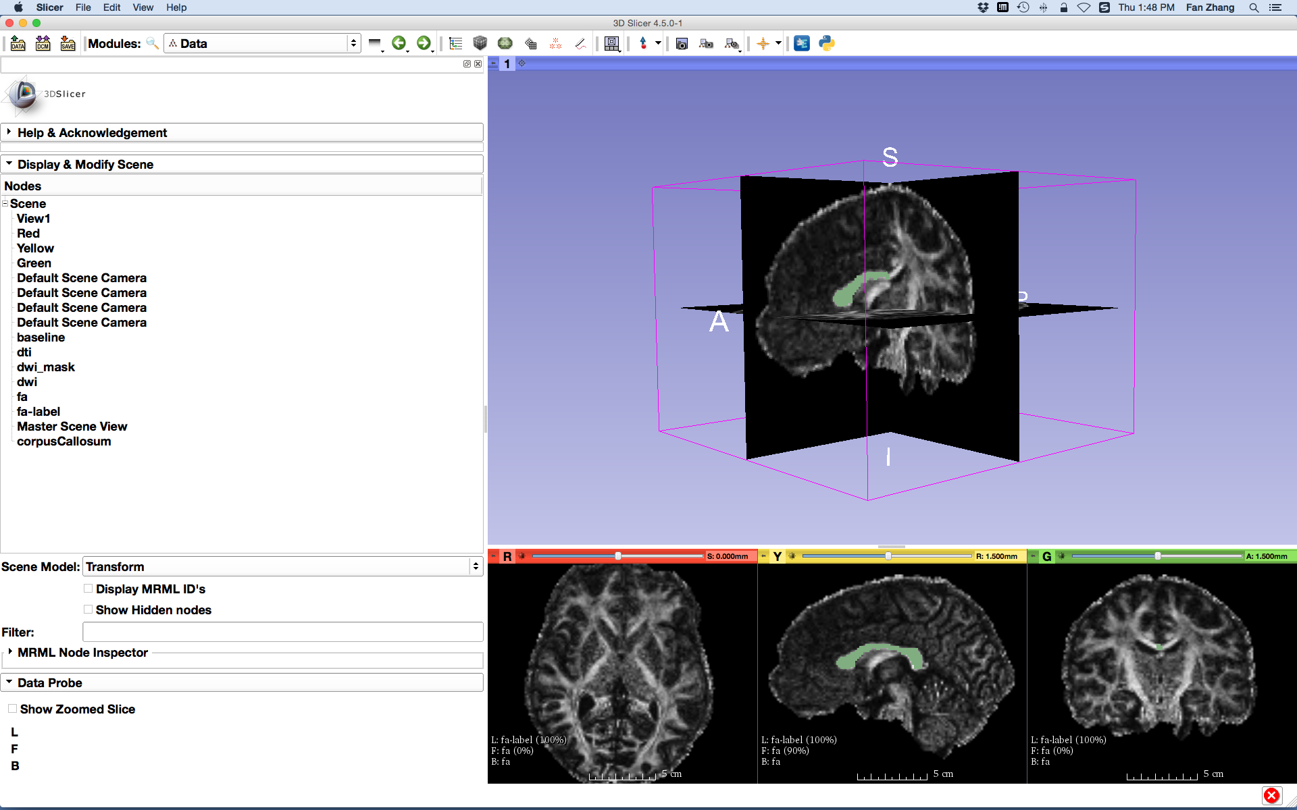
Load MRML Data
Data loaded for this tutorial:
dwi
dwi_mask
baseline
dti
fa
fa-label
corpusCallosum
Notes:
including the dwi data, dwi_mask file that is brain mask, and b0 image, dti data, fa image. And a fa-label, which is the label map we use to draw the multiple labels form CC. This label map is from the DTI tutorial and it has the entire CC label only. We are going to draw additional labels on it.
And finally, we have a vtk file of CC that is also from the DTI tutorial, we will use this for comparisons later.

Slide 9
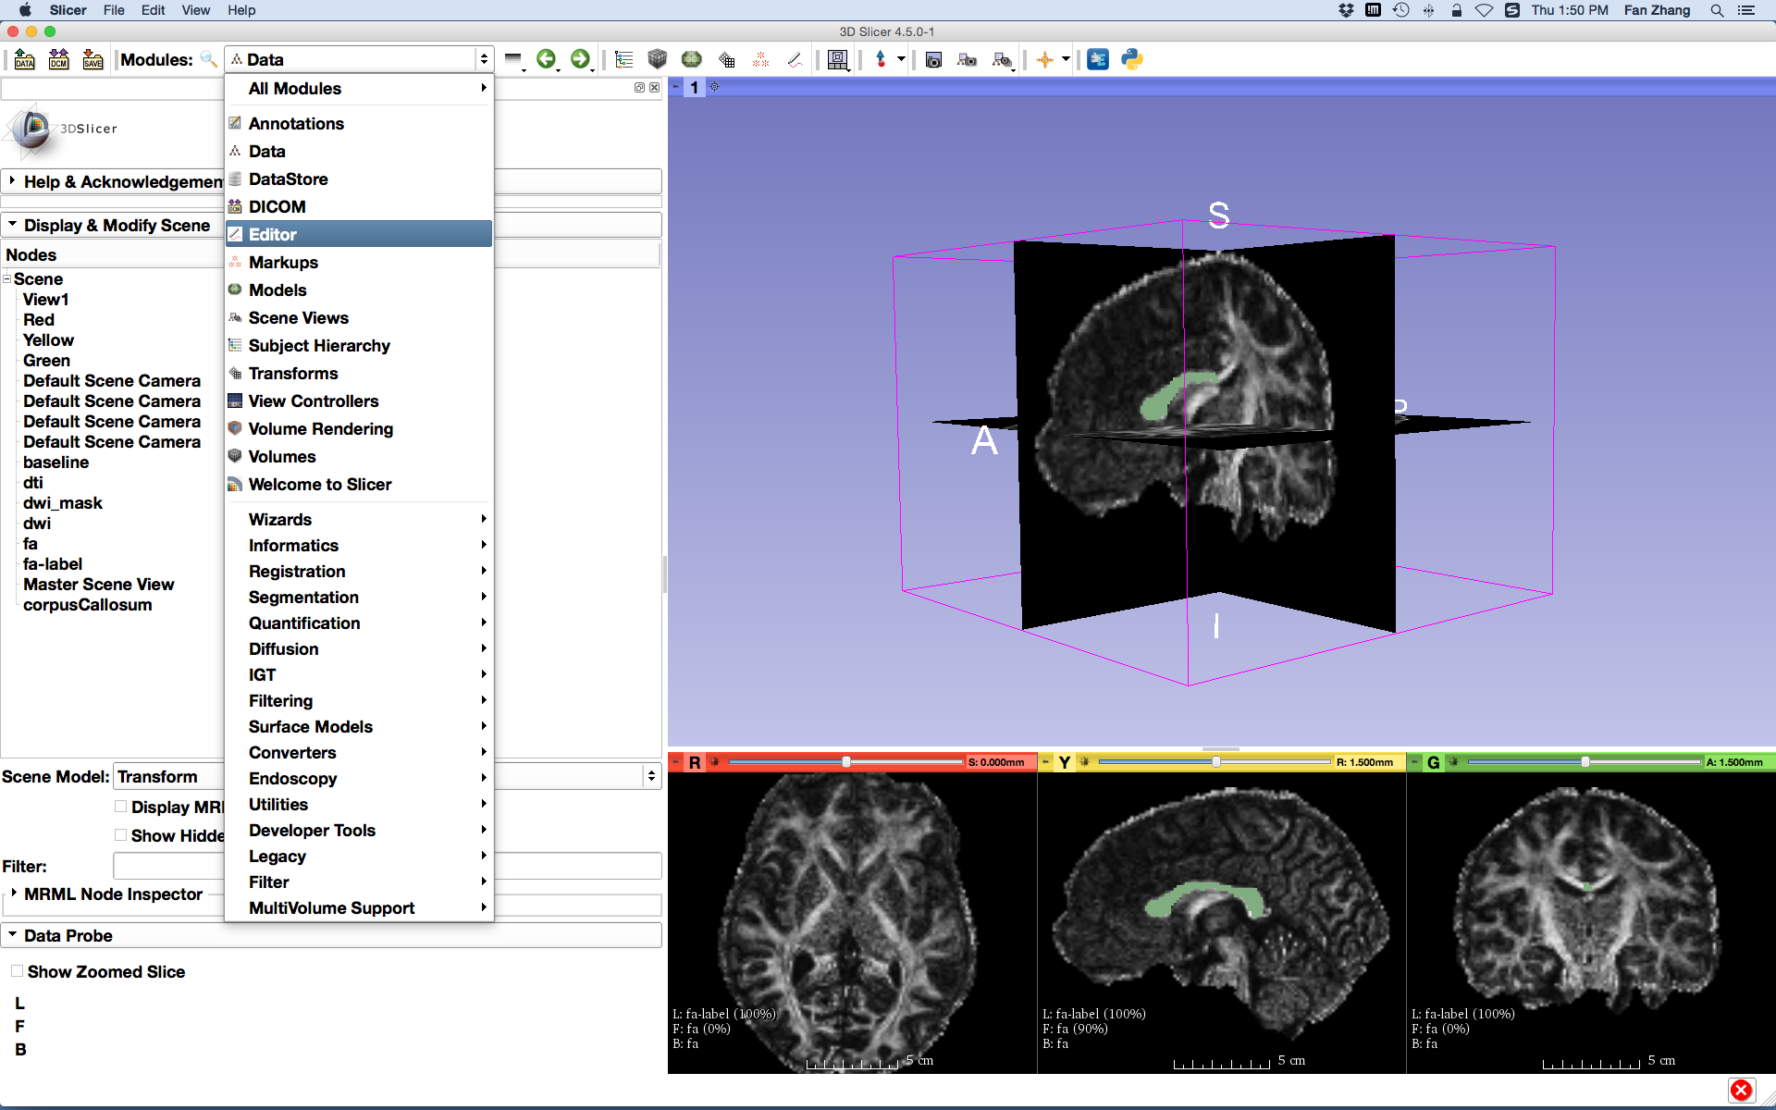
Edit Multiple Labels
Select the module Editor
Notes:
Now, let’s draw some other labels on the label map, with the module Editor. As this label editing and tractography have been introduced more detailed in the DTI tutorial. So, here I just give a brief illustration of them.

Slide 10
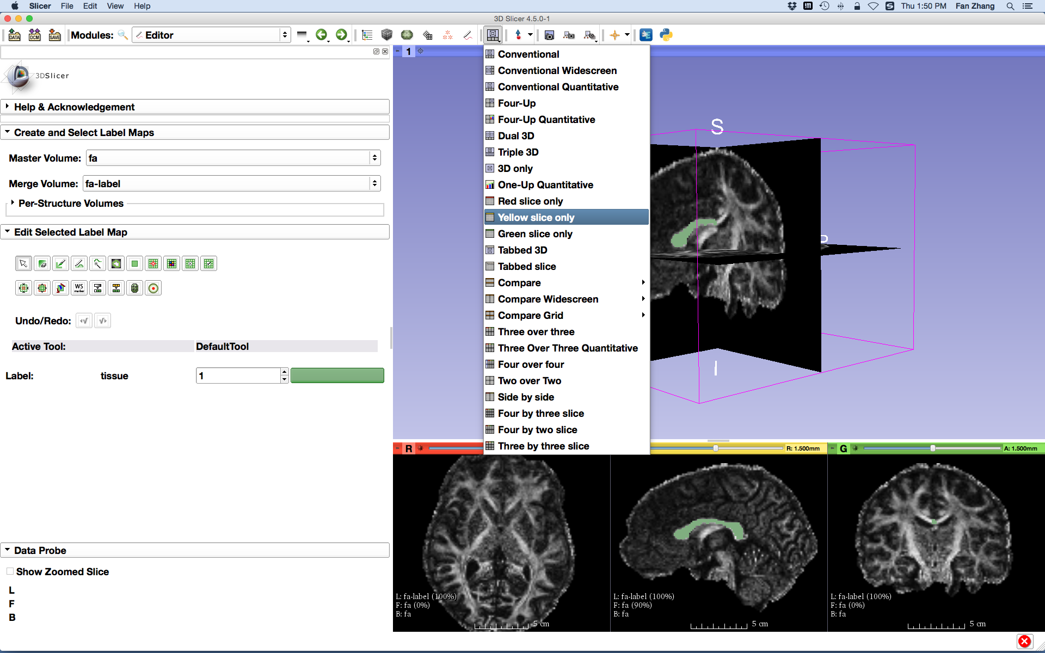
Edit Multiple Labels
Select the Yellow slice only layout
Notes:
Go the yellow view

Slide 11
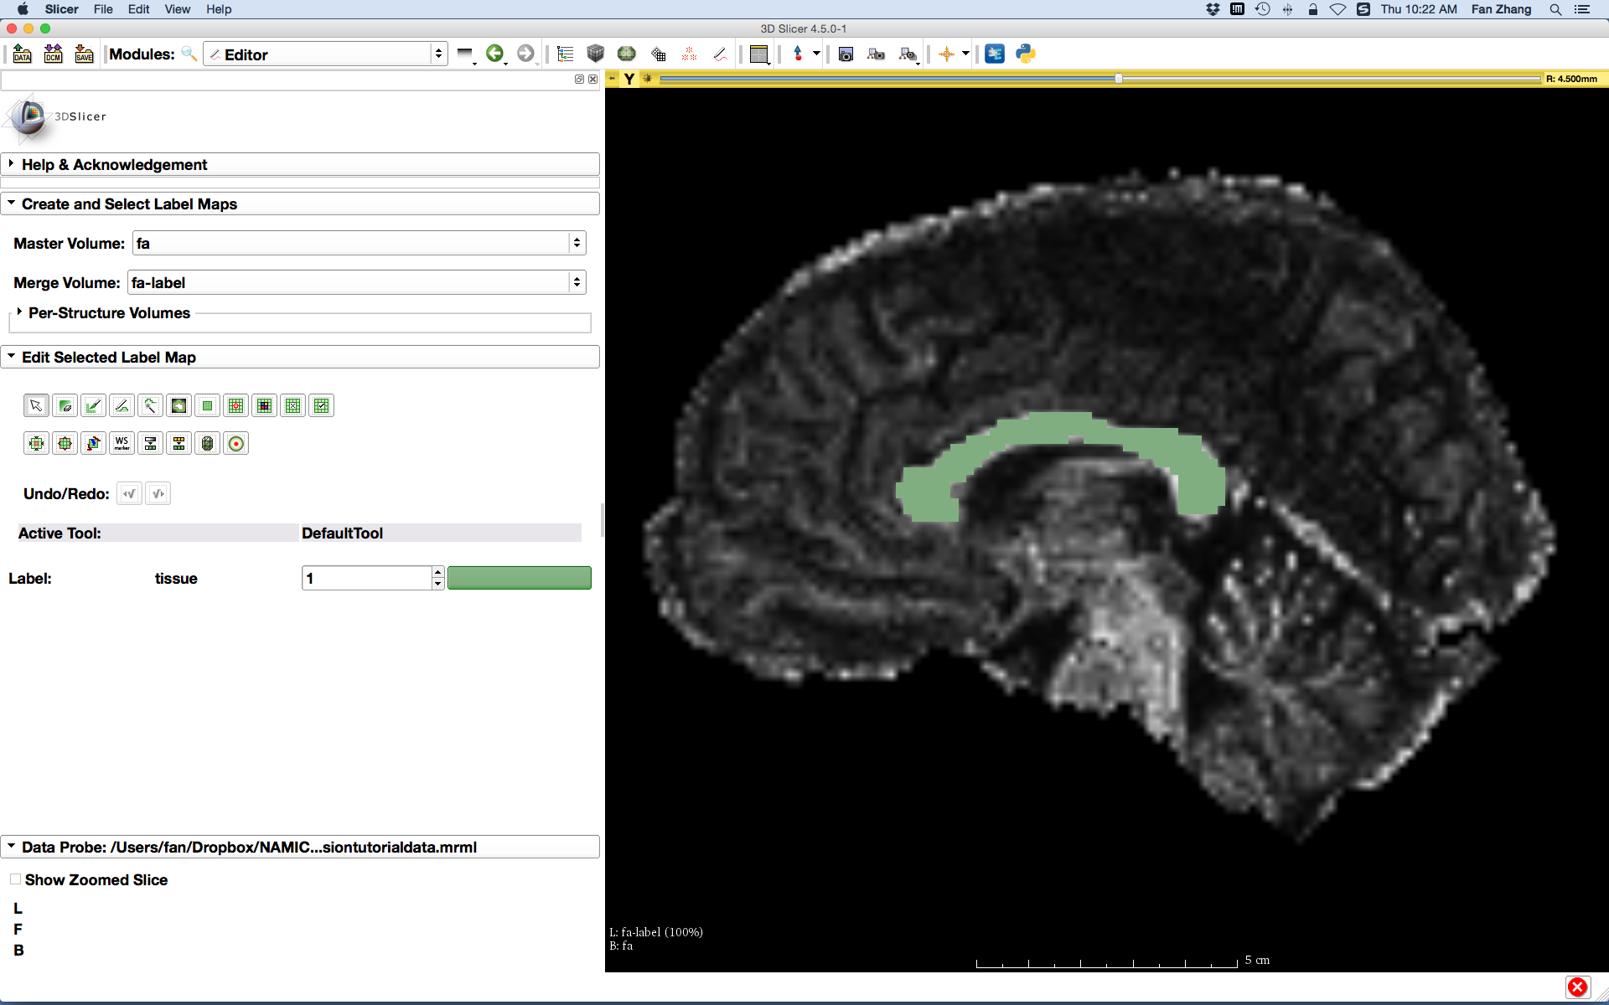
Edit Multiple Labels
- Set the Master Volume parameter to fa
- Set the Merge Volume parameter to fa-label
Notes:
And select the Master Volume as fa, and Merge Volume as fa-label. Then you’ll see the label of the entire CC that already existed.

Slide 12
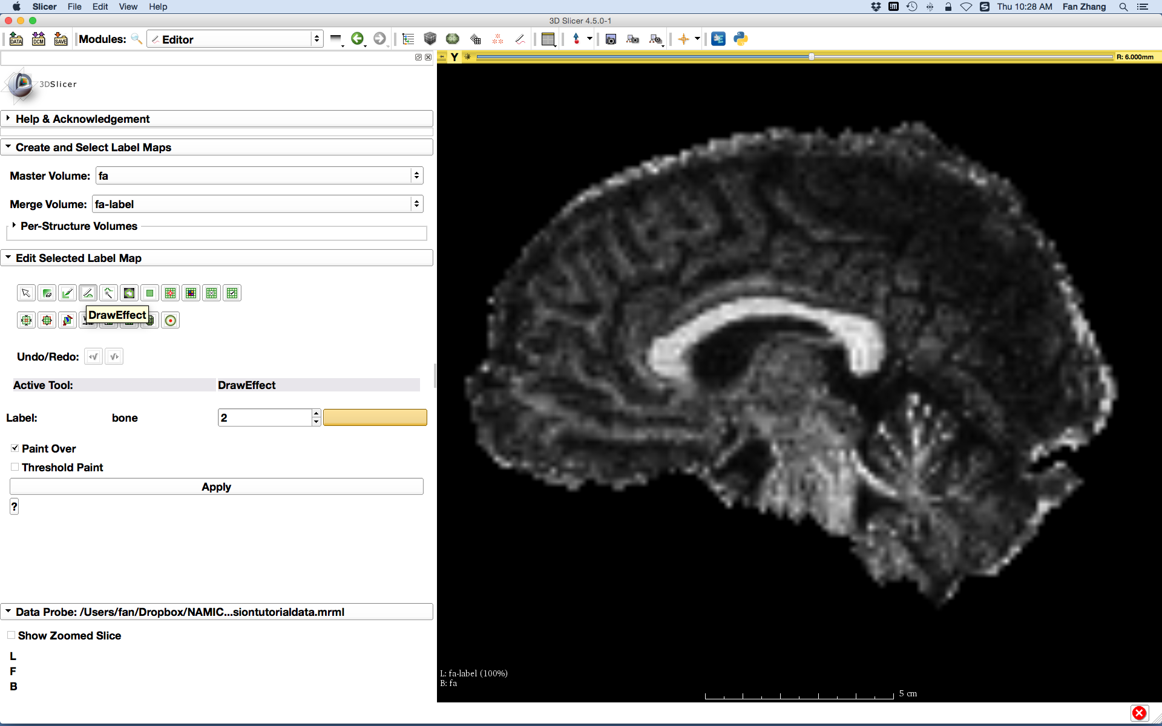
Edit Multiple Labels
Use the arrow keys on the keyboard to step to a slice where is no label shows
- Select the DrawEffect tool
- Set the Label to 2
Notes:
The, move to the next slice and use the DrawEffect and chose the label to 2.

Slide 13
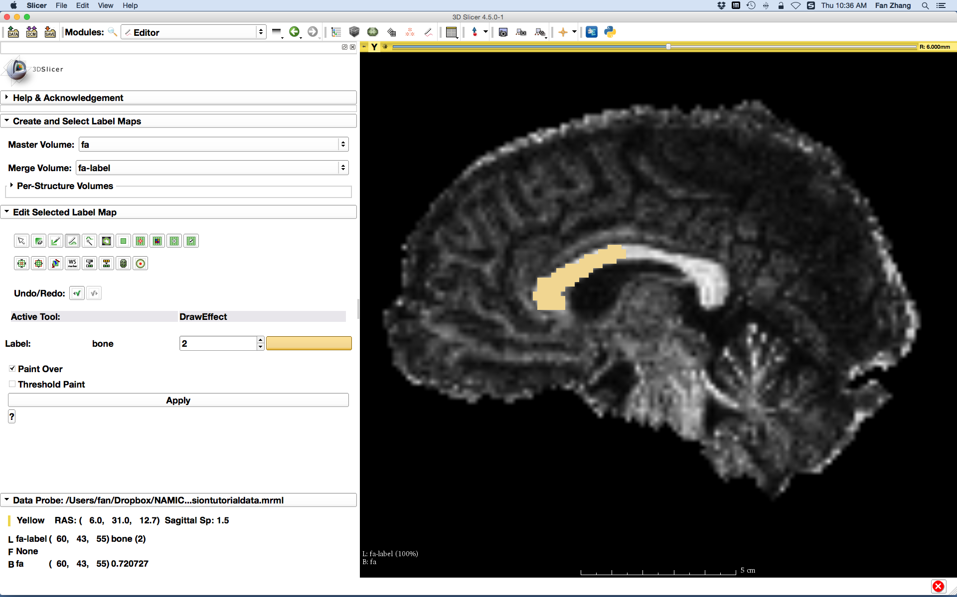
Edit Multiple Labels
Outline the contour of the anterior of Corpus Callosum with the DrawEffect tool and press enter.
Notes:
And draw the anterior part of CC.

Slide 14
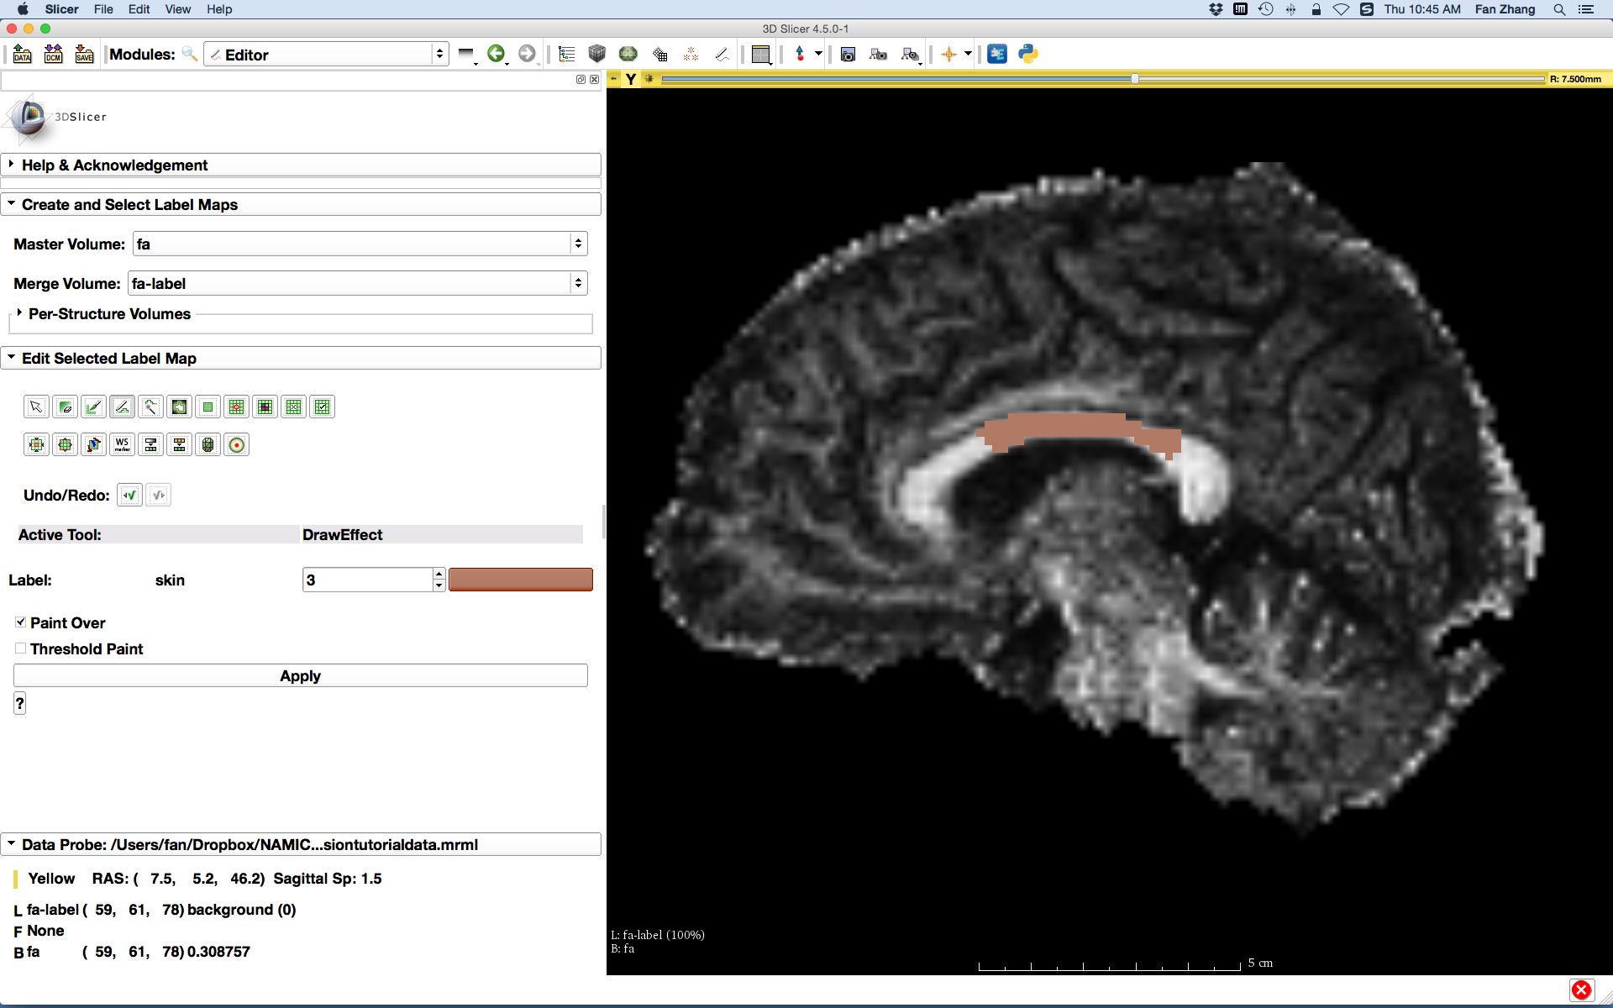
Edit Multiple Labels
Repeat the above steps to draw the middle of Corpus Callosum with label 3 on the next slice
Draw the middle area with a purposeful overlap with the anterior area to see the fiber selection
Notes:
Similarly, draw the middle part with label3.

Slide 15
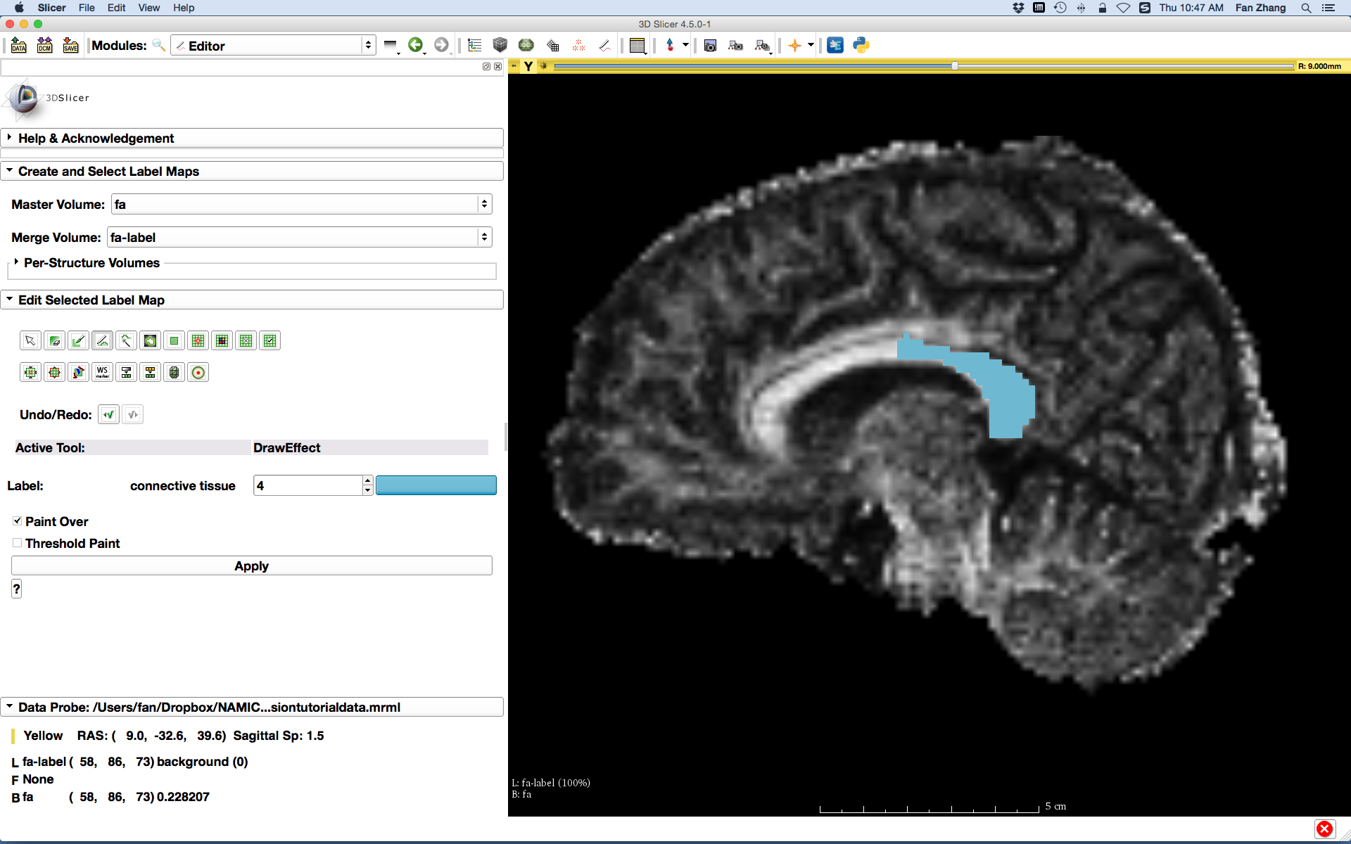
Edit Multiple Labels
Repeat the above steps to draw the posterior of Corpus Callosum with label 4 on the next slice
Draw the posterior area with a purposeful overlap with the middle area to see the fiber selection
Notes:
The posterior part with label 4

Slide 16
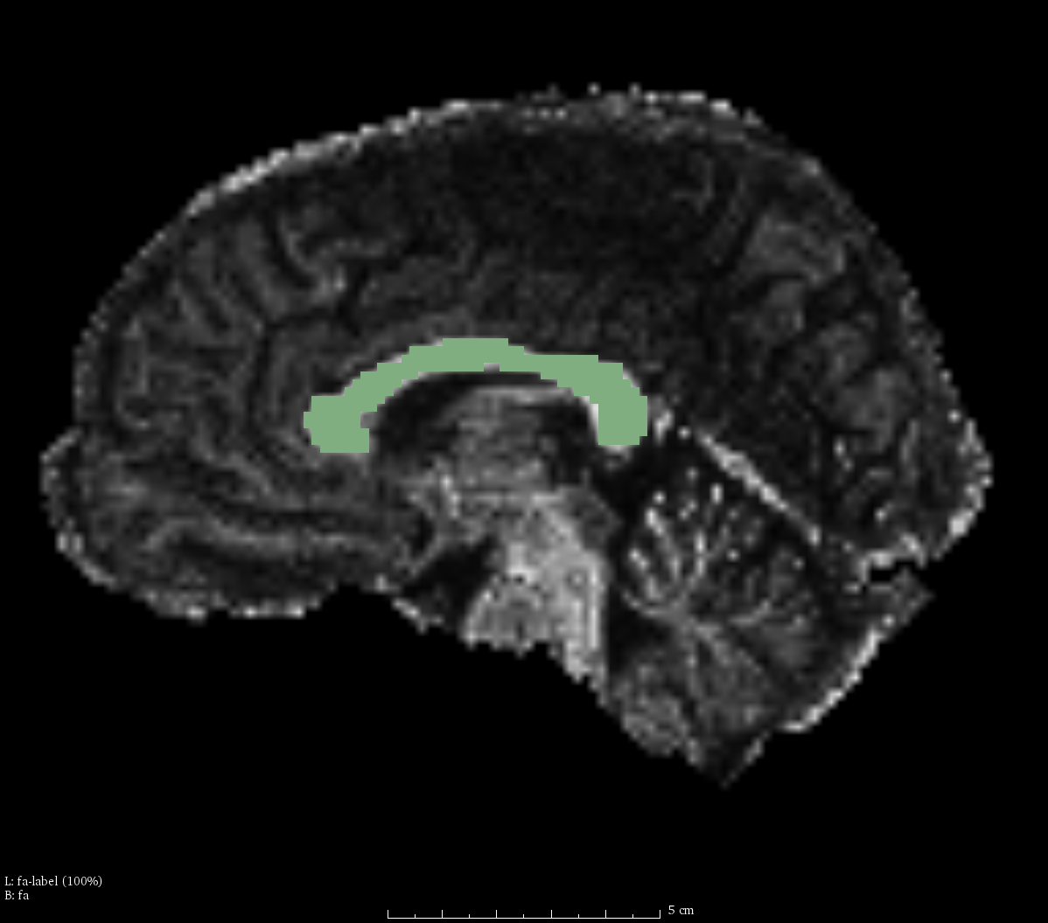
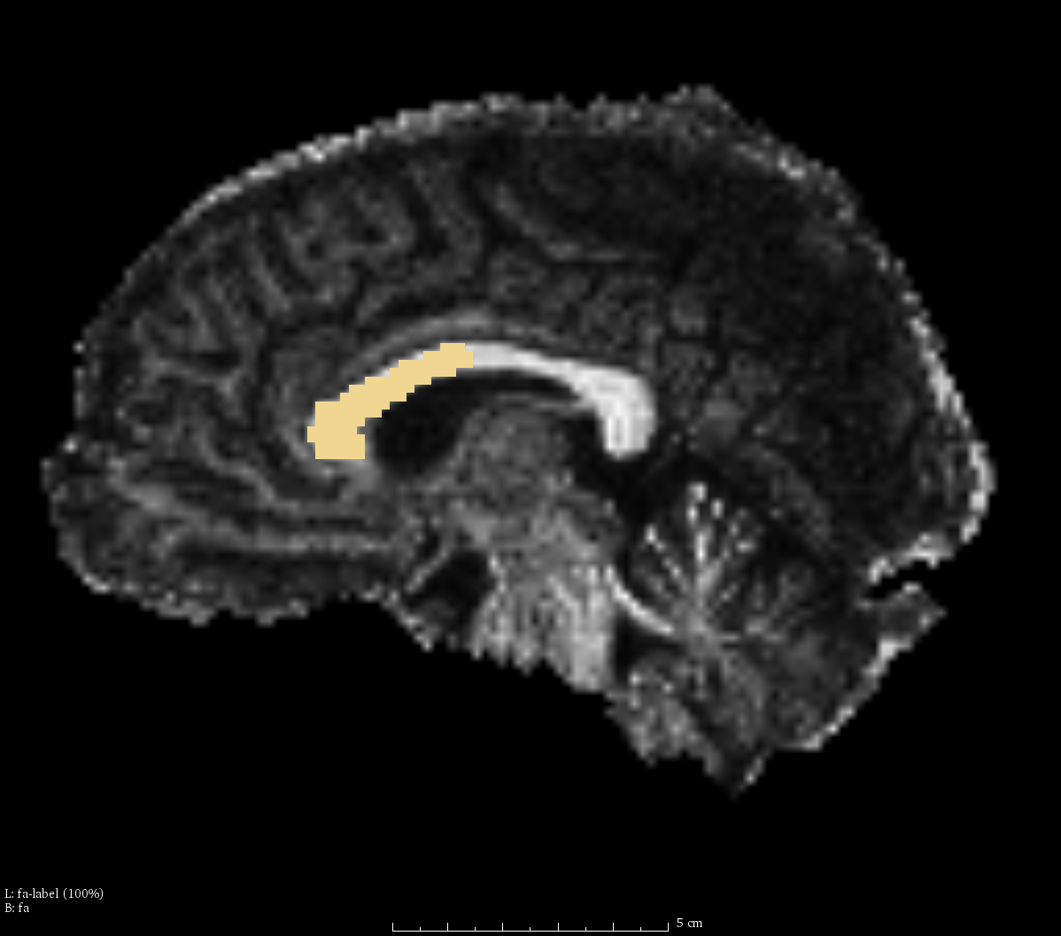
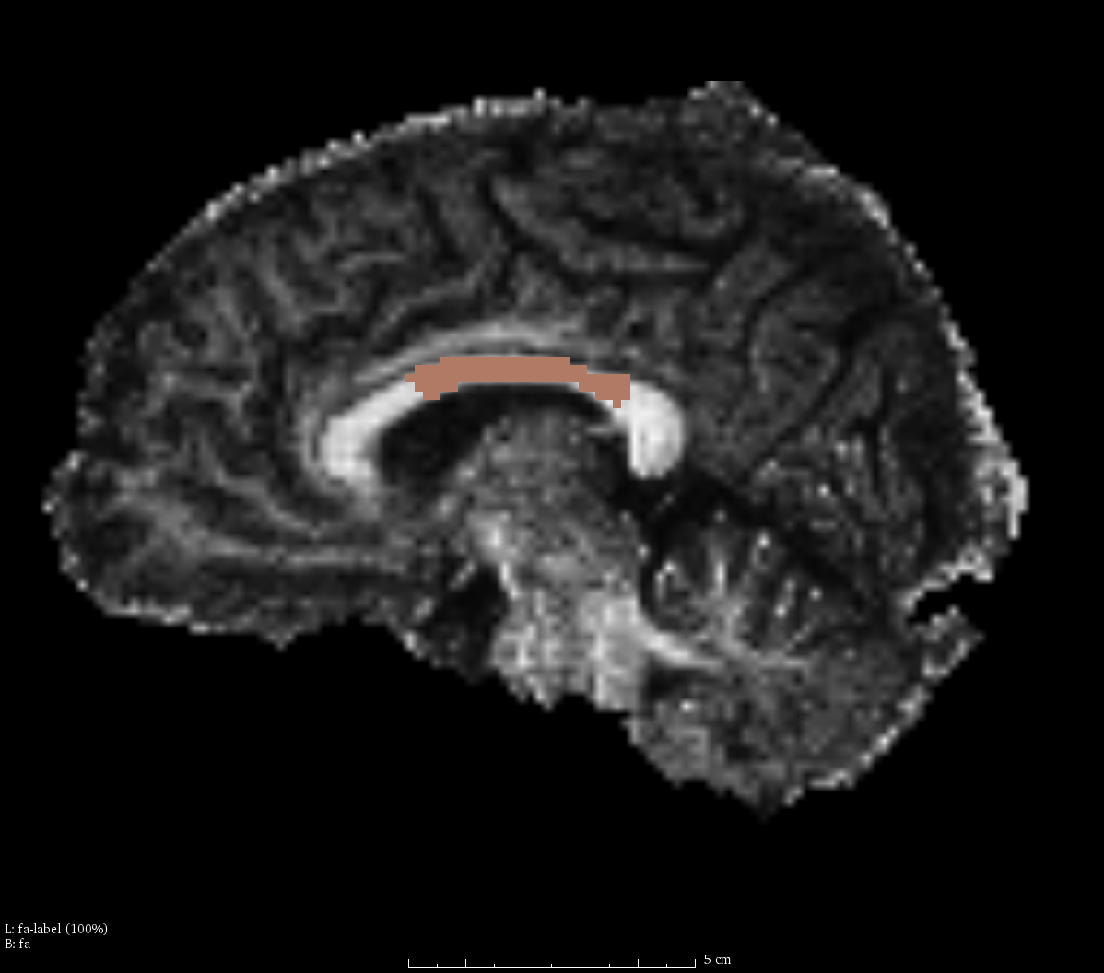
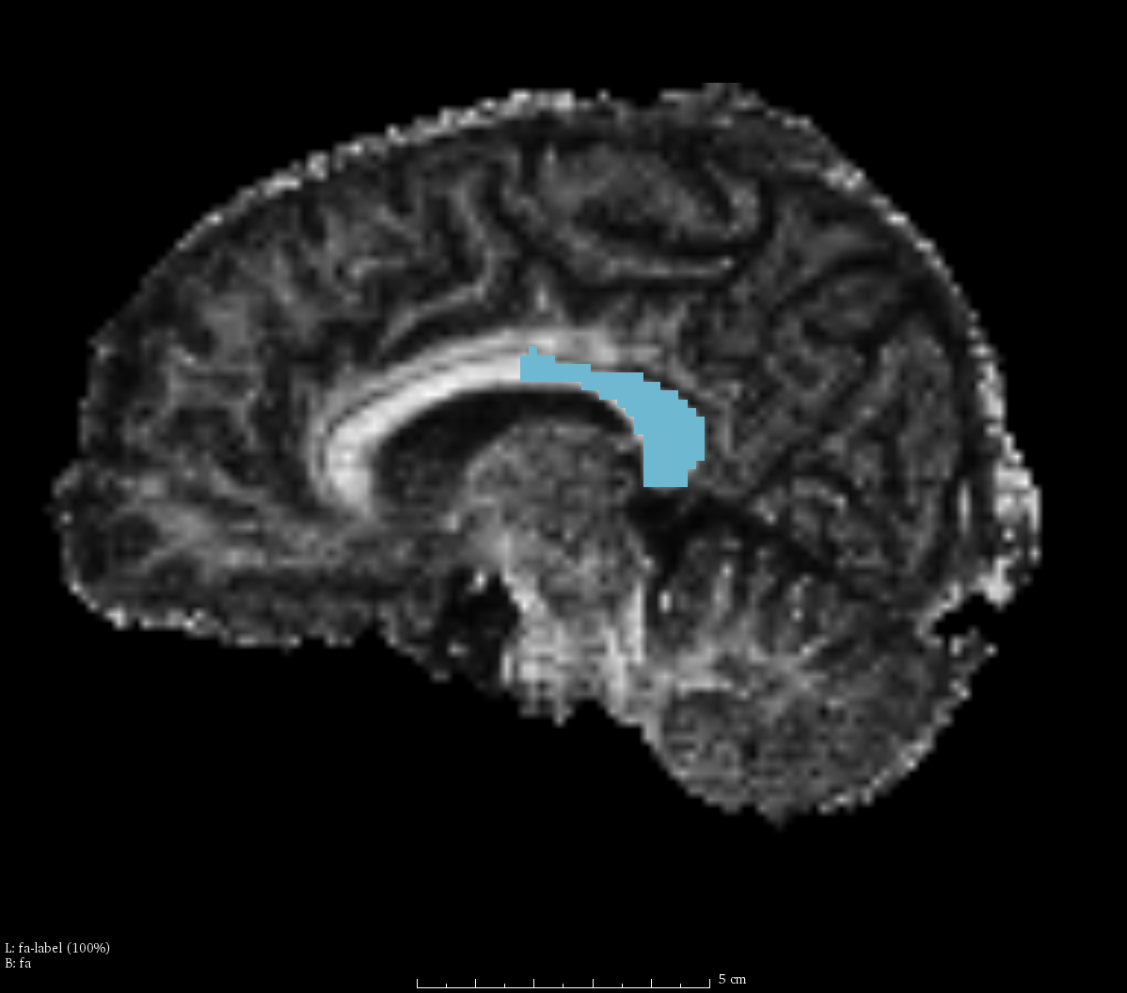
Edit Multiple Labels
Label map on individual slice, with :
1 - entire CC
2 - anterior CC
3 - middle CC
4 - posterior CC
Notice that there are overlaps between different labeled regions*, which will be used to investigate the fiber bundle selection.
* For details of CC segments: http://adessowiki.fee.unicamp.br/adesso/wiki/DTI/proj_cc/view/
Notes:
Now we four labels with 1 of entire CC, 2 with anterior CC, 3 with middle CC and 4 with posterior CC.

Slide 17
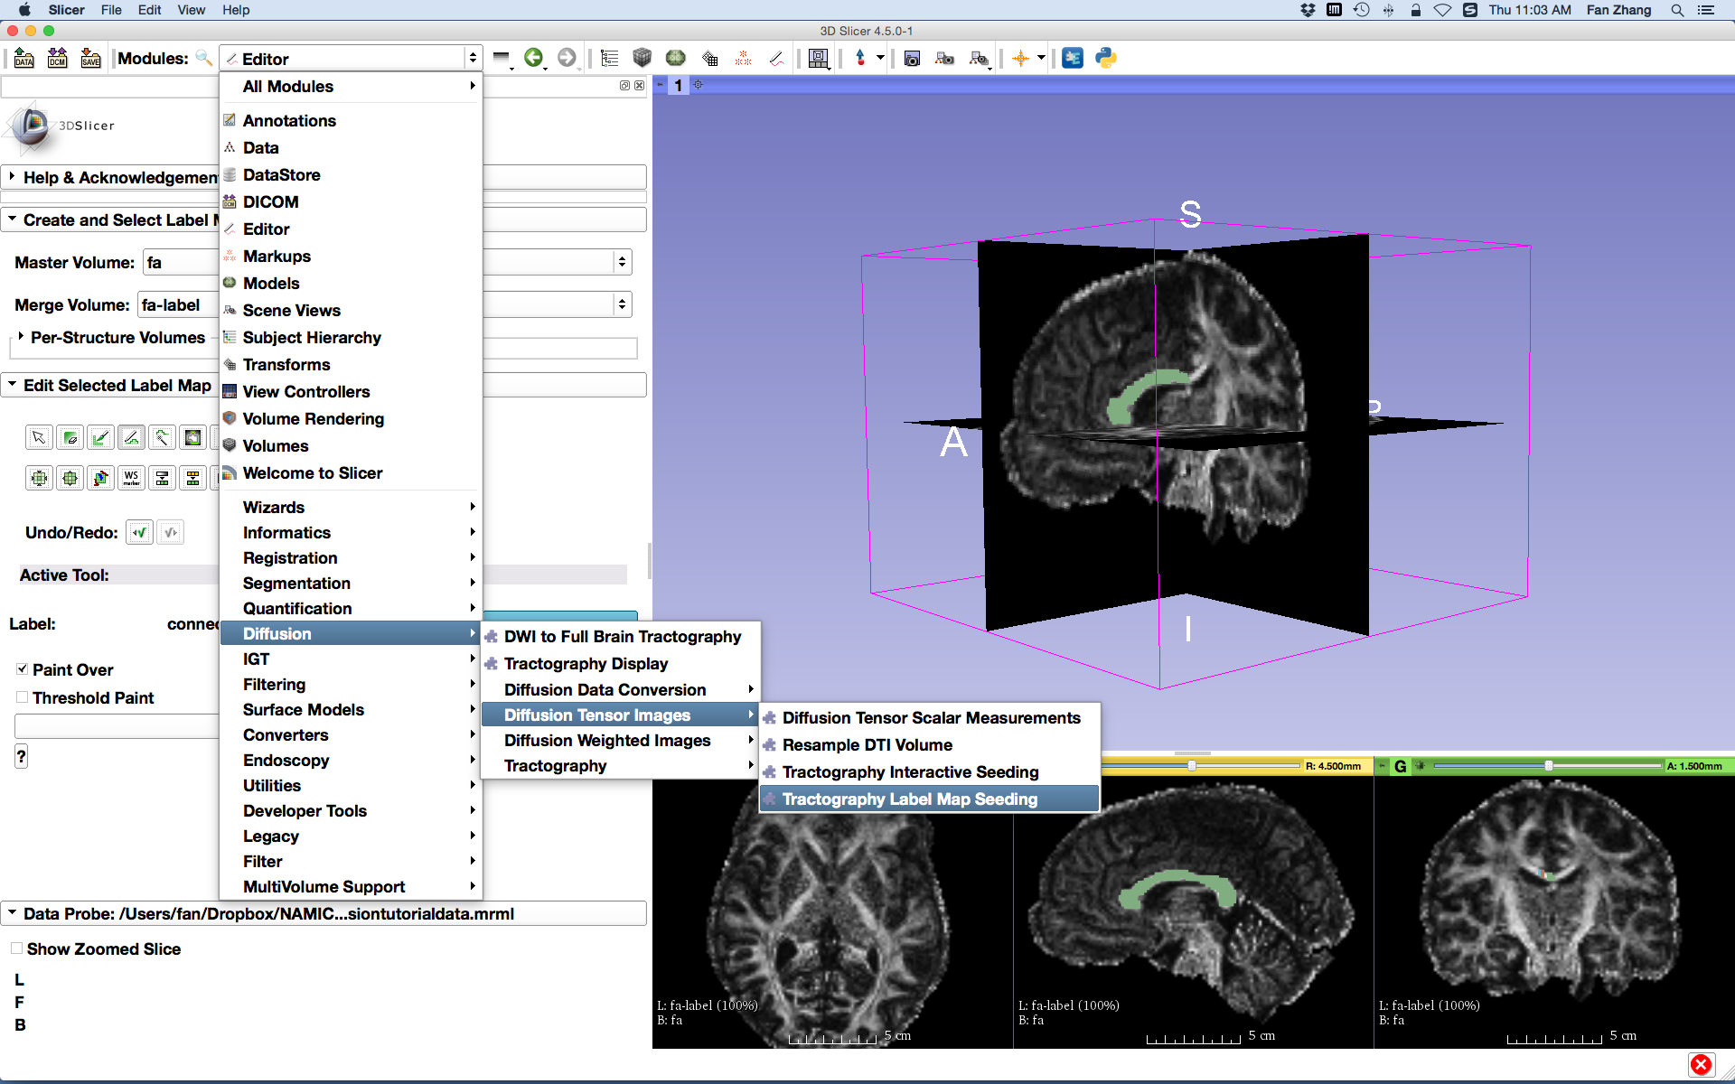
Whole Brain Tractography
Go back to the Conventional layout
Select the module
Tractography Label Map Seeding
Notes:
Then, let do the whole brain tractography with the Module Tractography Label Map Seeding

Slide 18
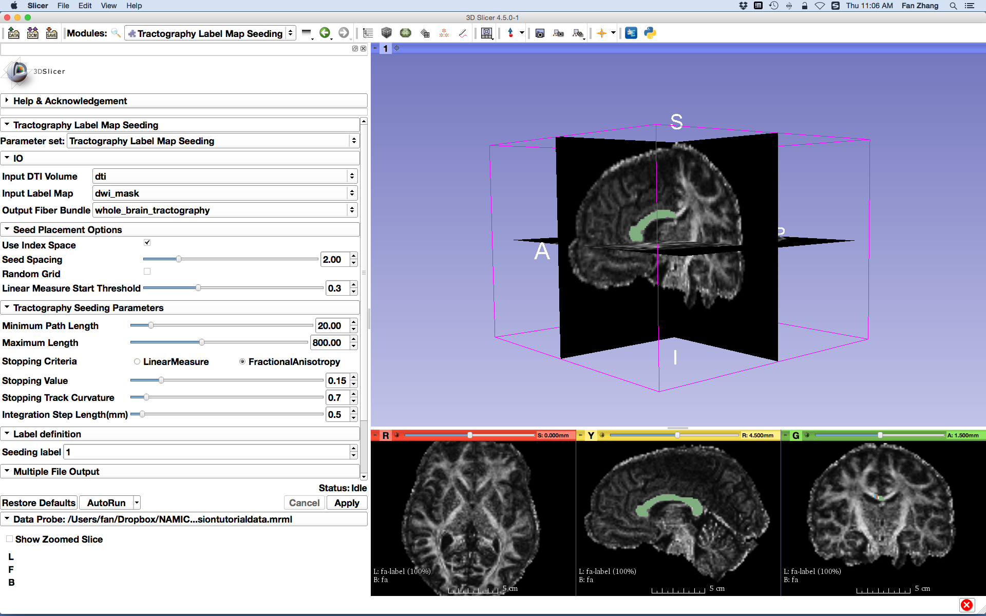
Whole Brain Tractography
Select the Tractography Seeding parameters:
- Input DTI volume: dti
- Input Label Map: dwi_mask
- Create and rename Output Fiber Bundle:
whole_brain_tractography
- Check Use index Space
- Stopping Criteria: FractionalAnistropy
- Stopping Value: 0.15
- Seeding label: 1
Click the button Apply
It may take a couple of minutes to finish the tractography
Notes:
Select parameters for this module. Please notice to select the input label map as dwi_mask to do the whole brain tractography. Click apply to run the tractography.

Slide 19
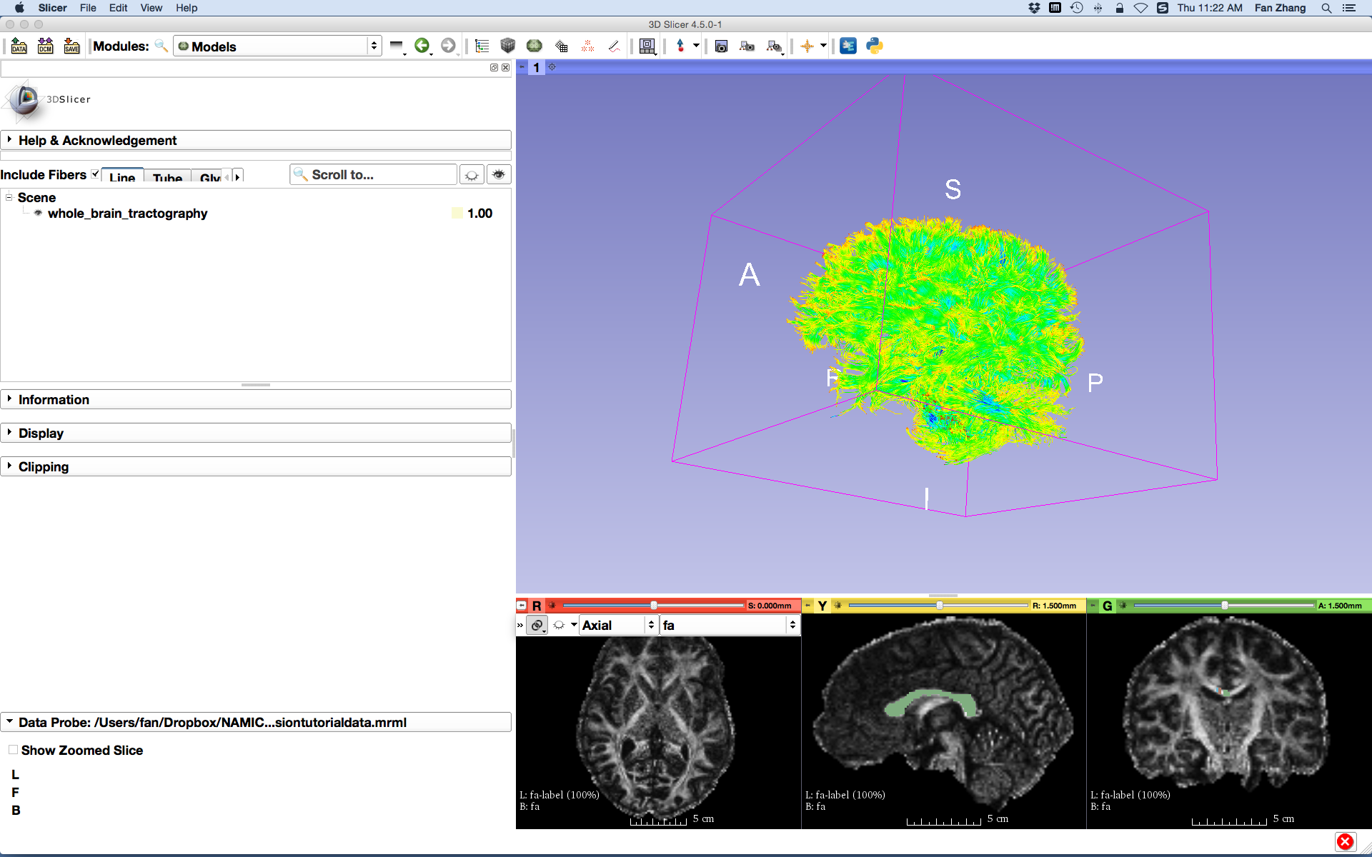
Whole Brain Tractography
Select the module Models
Check Include Fibers
Uncheck Toggle slice visibility in 3D view
Notes:
After finishing, let’s go to the Models module to view the tractography.

Slide 20
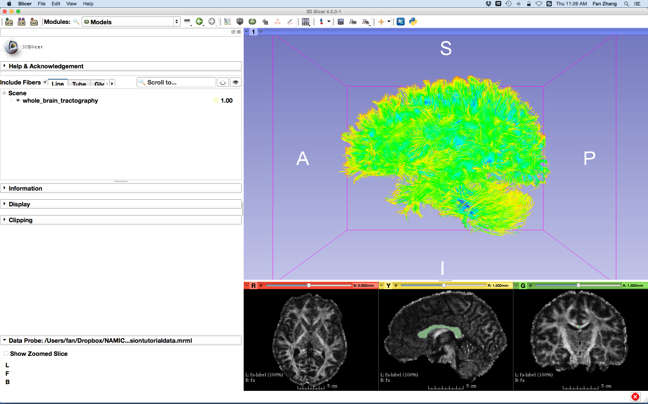
Whole Brain Tractography
Whole brain tractography by seeding within the entire brain is displayed in the 3D view of Slicer

Slide 21
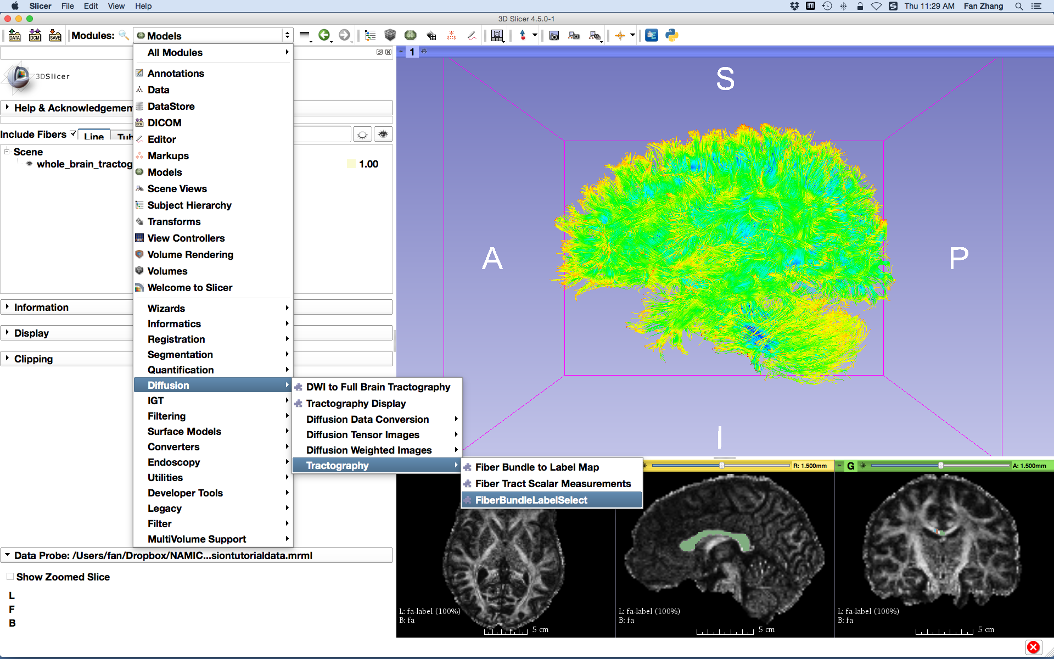
Fiber Bundle Label Selection
Select the module FiberBundleLabelSelect
Notes:
Next step, let do the fiber bundle selection, go to the module FiberBundleLabelSelect under the category of Diffusion/tractography.

Slide 22
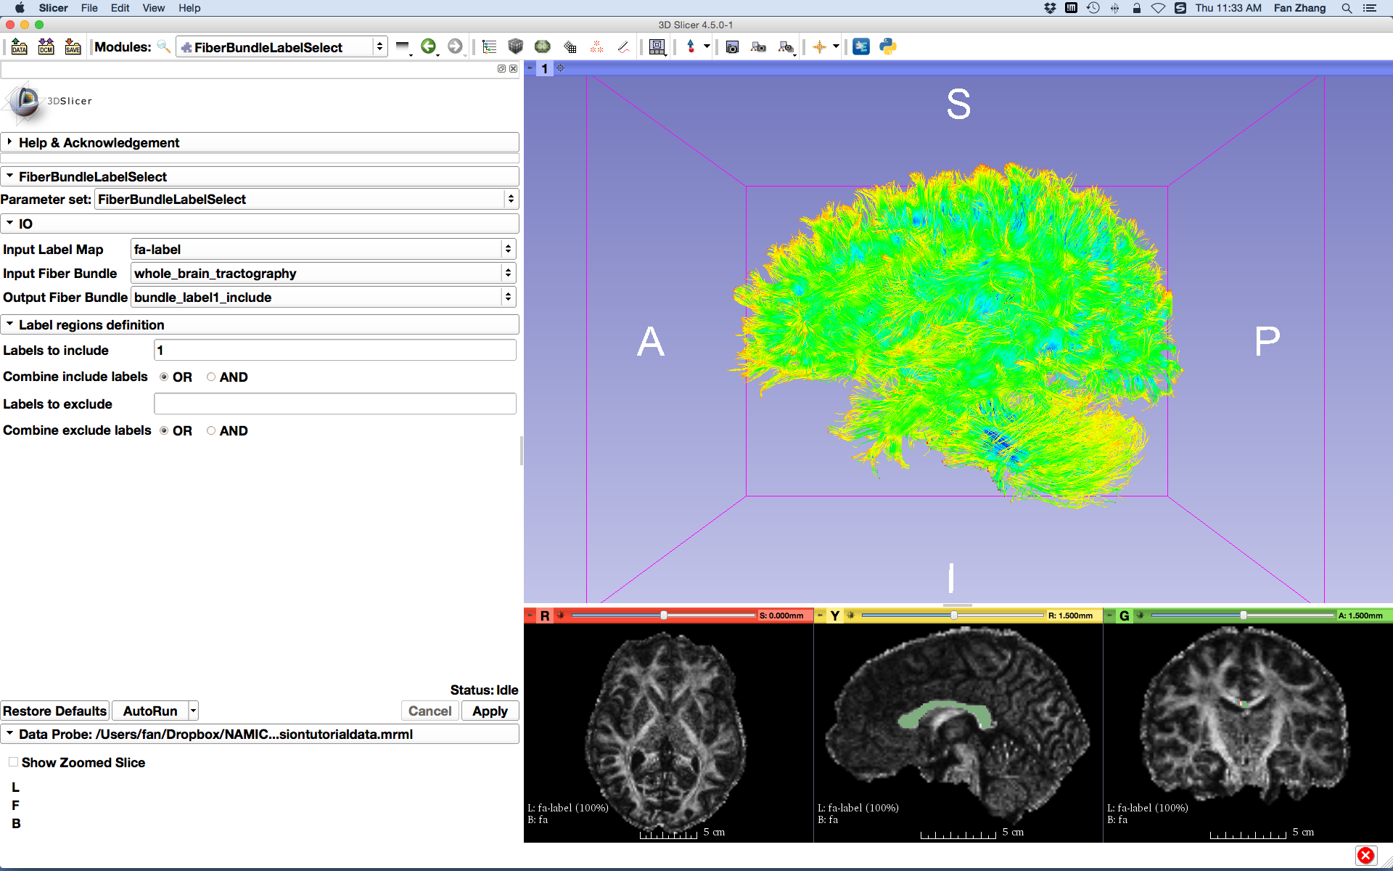
Single Label Selection
Set the FiberBundleLabelSelection parameters:
- Input Label Map: fa-label
- Input Fiber Bundle:
whole_brain_tractography
- Create and rename Output Fiber Bundle:
bundle_label1_include
- Labels to include: 1
Click the button Apply
Notes:
Set the parameters, Input Label Map: fa-label, Input Fiber Bundle, whole_brain_tractography , Output Fiber Bundle: bundle_label1_include, - Labels to include: 1
Notice, here we use the label map of fa-label, which contains the different regions we just obtained, not the whole brain mask.
And we want to see the fibers passing through the entire CC, so here we set the parameter of Labels to include to 1.
Then click apply to do the selection.

Slide 23
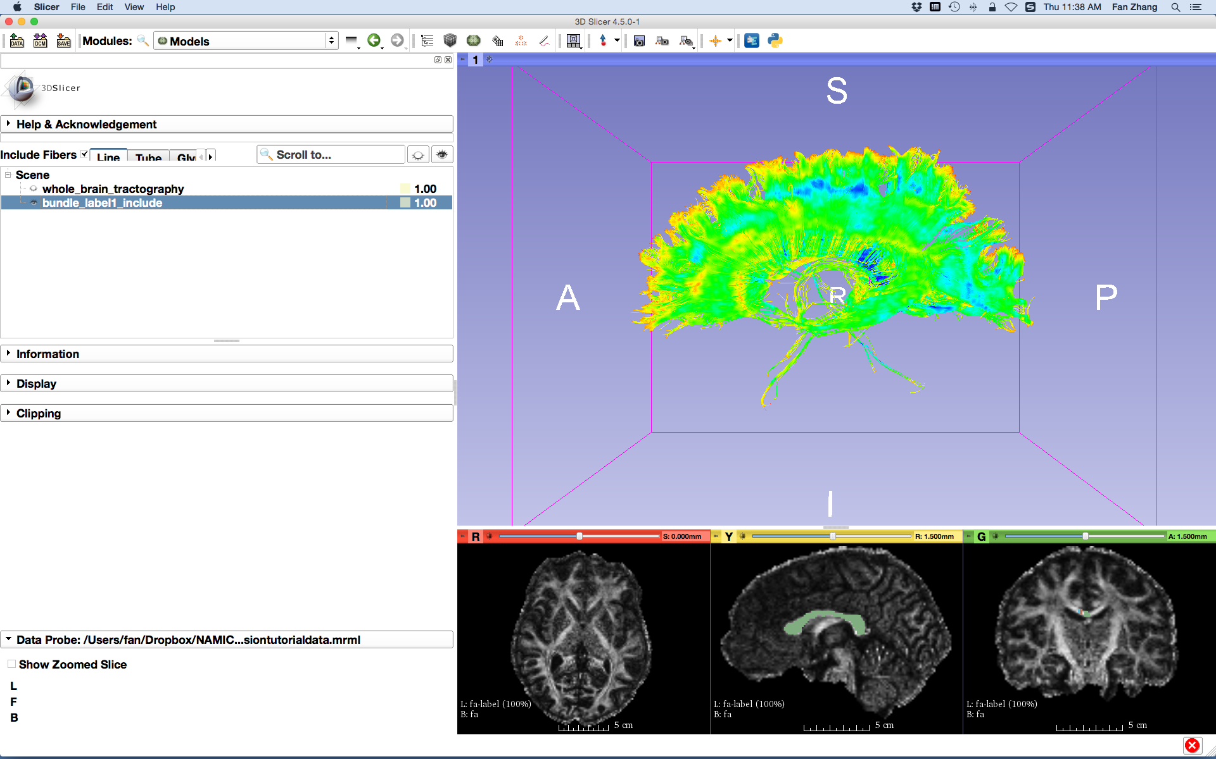
Single Label Selection
Select the module Models
Check the visibility of bundle_label1_include only
The fiber bundle from the whole brain tractography that passes through label 1 is displayed
Notes:
Let go the Models module to see the selection results. In the 3D viewer, we have the bundle selected.

Slide 24
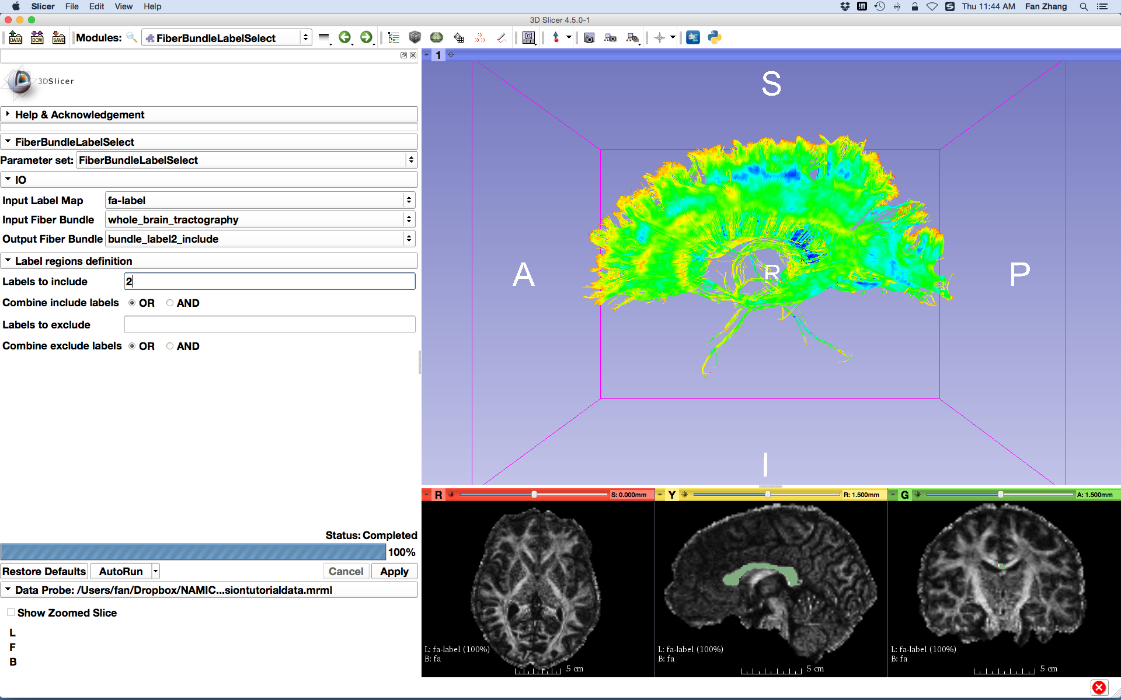
Single Label Selection
Repeat the above steps to perform fiber bundle selections of labels 2, 3 and 4 individually and obtain the selected bundles of bundle_label2_include, bundle_label3_include and bundle_label4_include respectively
Notes:
Then, let try different selection given the labels 2, 3 and 4.

Slide 25
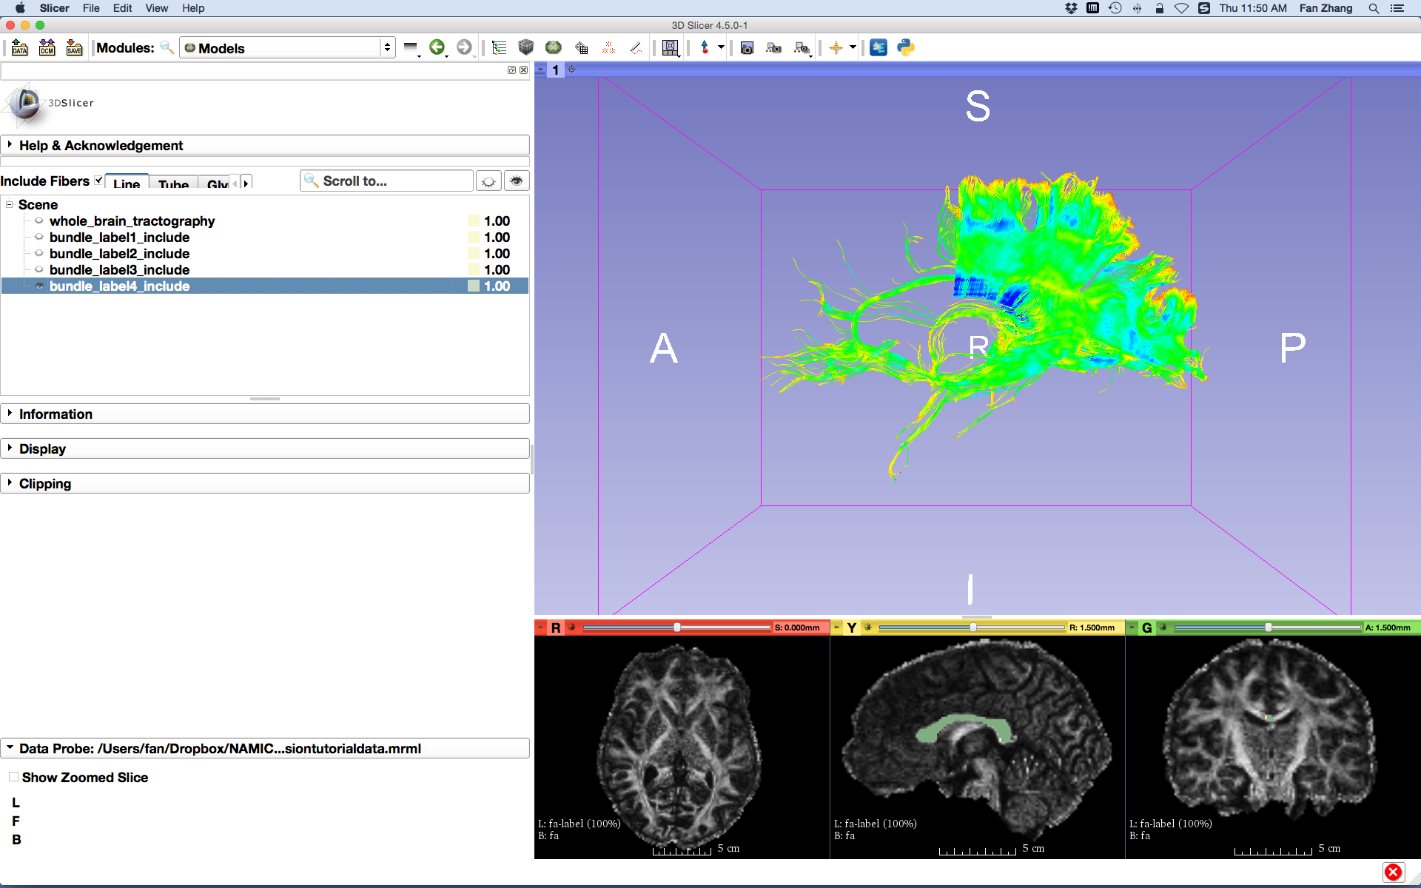
Single Label Selection
The Models module displays the fiber bundles obtained.

Slide 26
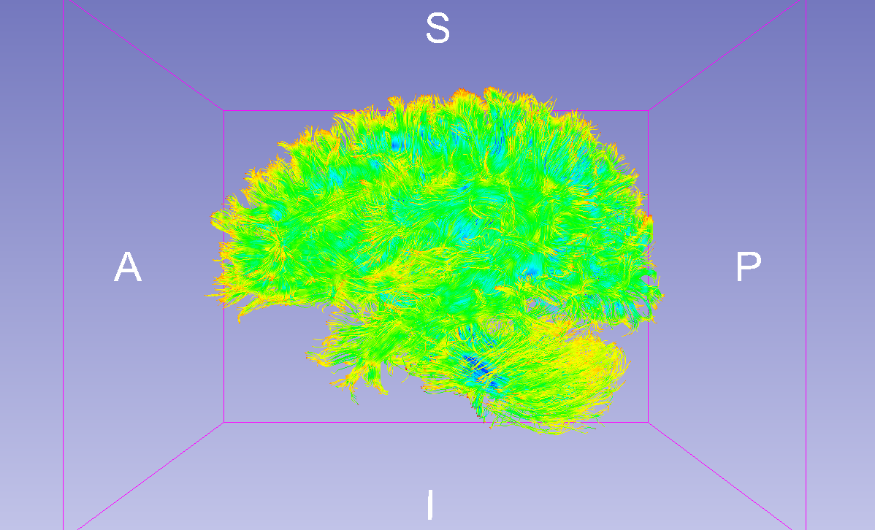
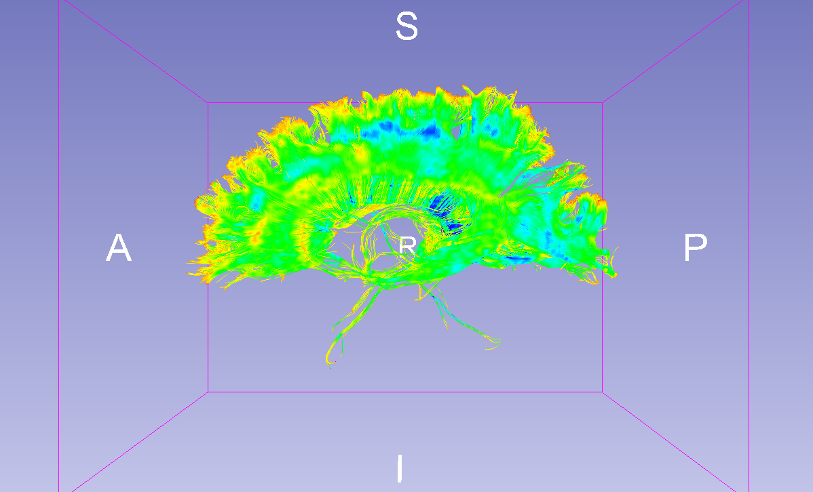
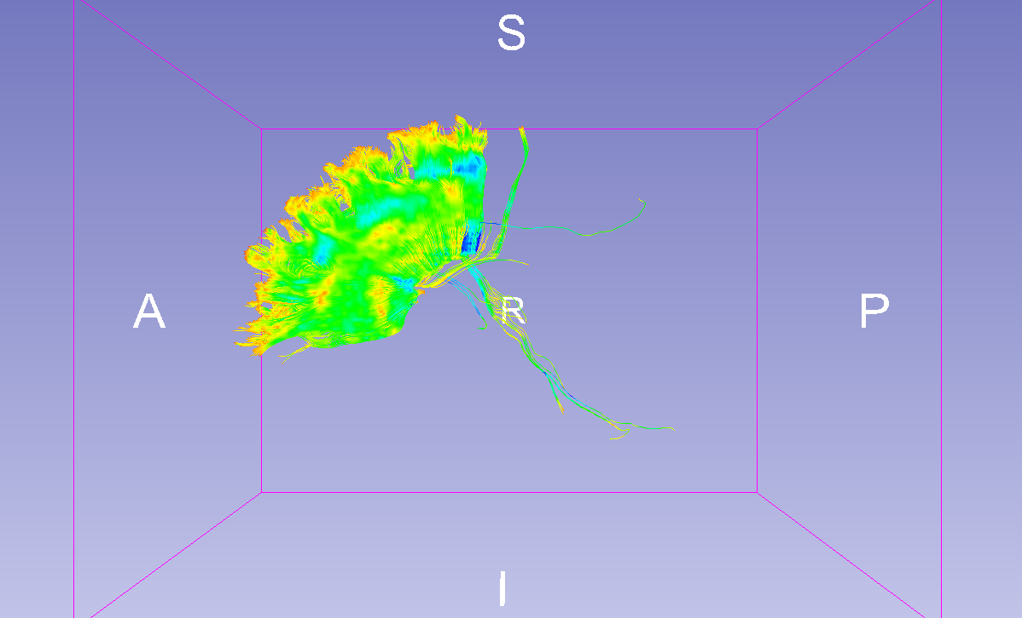
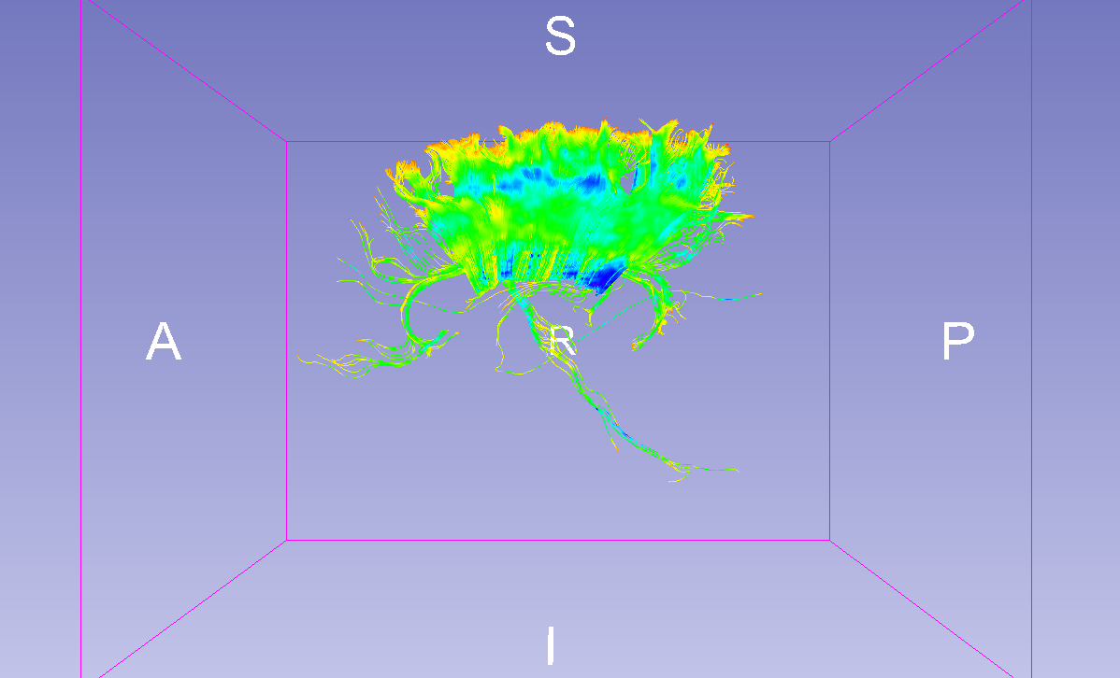
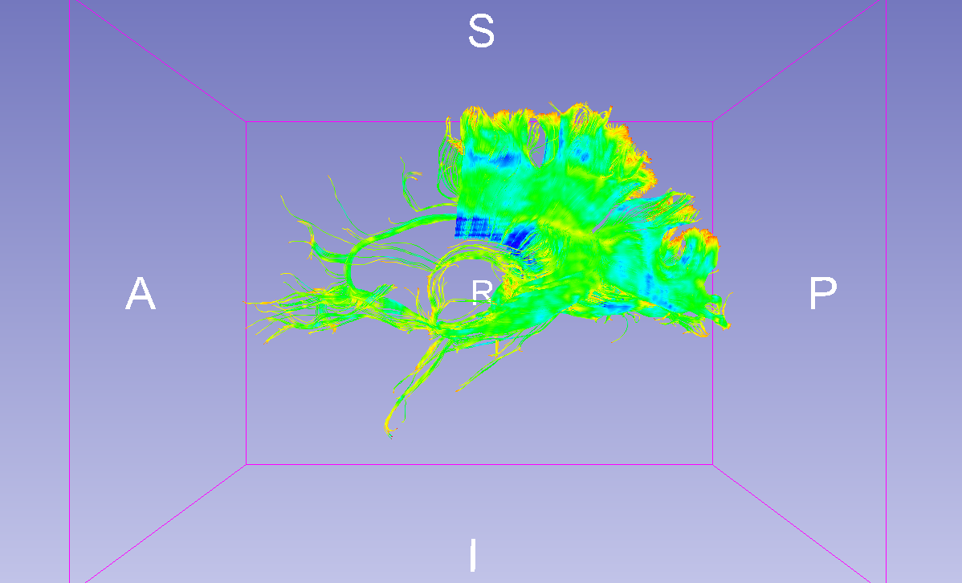
Single Label Selection
Whole Brain
Label 1
Label 2
Label 3
Label 4
Notes:
Here is the comparison of the different selection results, from the whole brain, the entire CC, the anterior, middle and posterior parts of CC

Slide 27
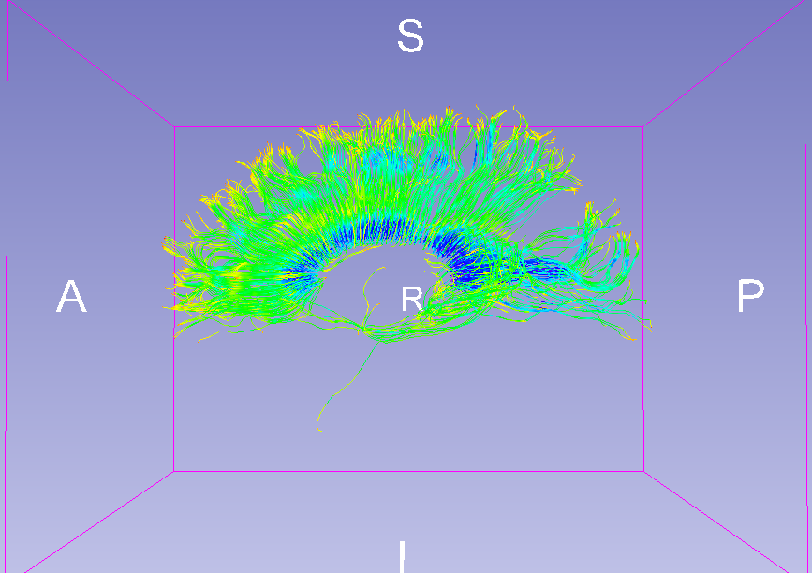
Single Label Selection
Notice that whole brain seeding creates a denser
fiber bundle than seeding from the label 1.
Fiber Bundle Selection of Label 1
from the Whole Brain Tractography
Fiber Bundle Obtained by
Seeding within Label 1
V.S.
By viewing corpusCallosum
loaded in the MRML file
Notes:
Here if you loaded the vtk file of corpusCallosum in the MRML file, you’ll see the difference of doing the whole brain tractography followed by the selection and the tractography seeding from the the label of CC only.

Slide 28
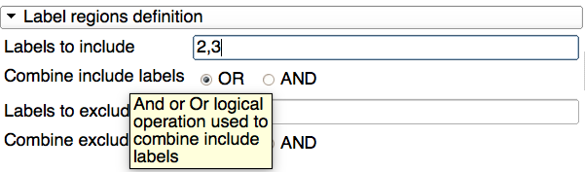
Multiple Labels Selection
FiberBundleLabelSelect allows users to perform multiple labels selection
by providing a list of labels and selecting one logical operation:
OR: fiber bundles that pass through any label in the list
AND: fiber bundles that pass through all labels in the list
Notes:
We can also do the multiple labels selection with the fiberbundlelabelselect module. There operation of OR and AND. OR means you can get the fibers that passing through any of the labels provided. ADD means getting the fibers that passing though all labels provided.

Slide 29
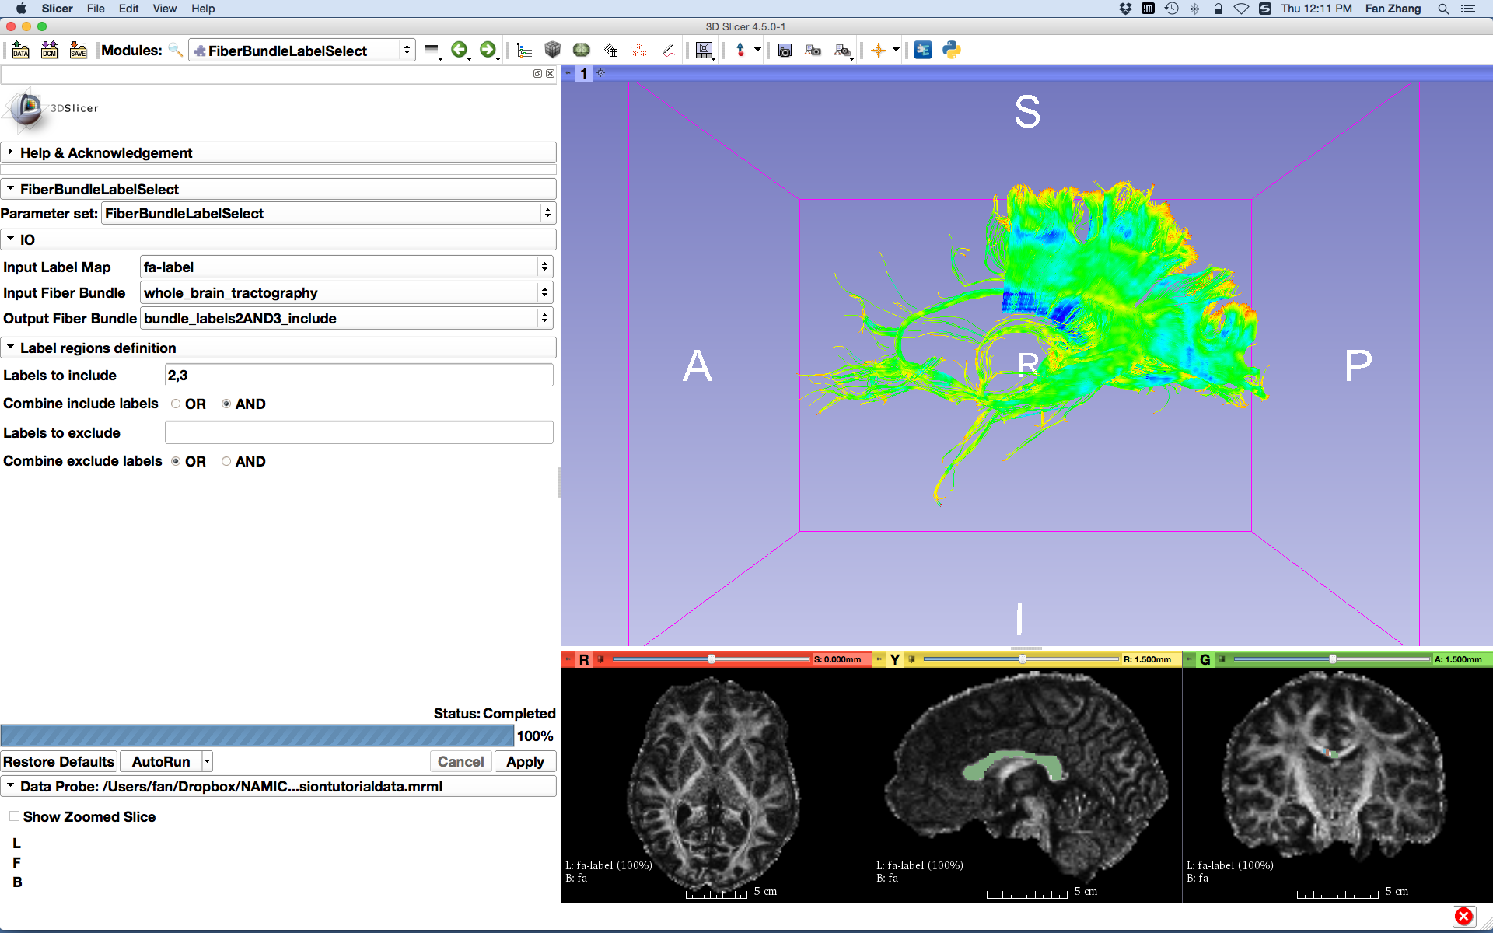
Multiple Labels Selection (AND)
Set the FiberBundleLabelSelection parameters:
- Input Label Map: fa-label
- Input Fiber Bundle:
whole_brain_tractography
- Create and rename Output Fiber Bundle:
bundle_labels2AND3_include
- Labels to include: 2,3
Set Combine include labels to AND
Click the button Apply
Notes:
Let do AND selection first. It is same as we do the single label selection, but you put multiple labels in Labels to include. Here we use 2 and 3. And click Apply.

Slide 30
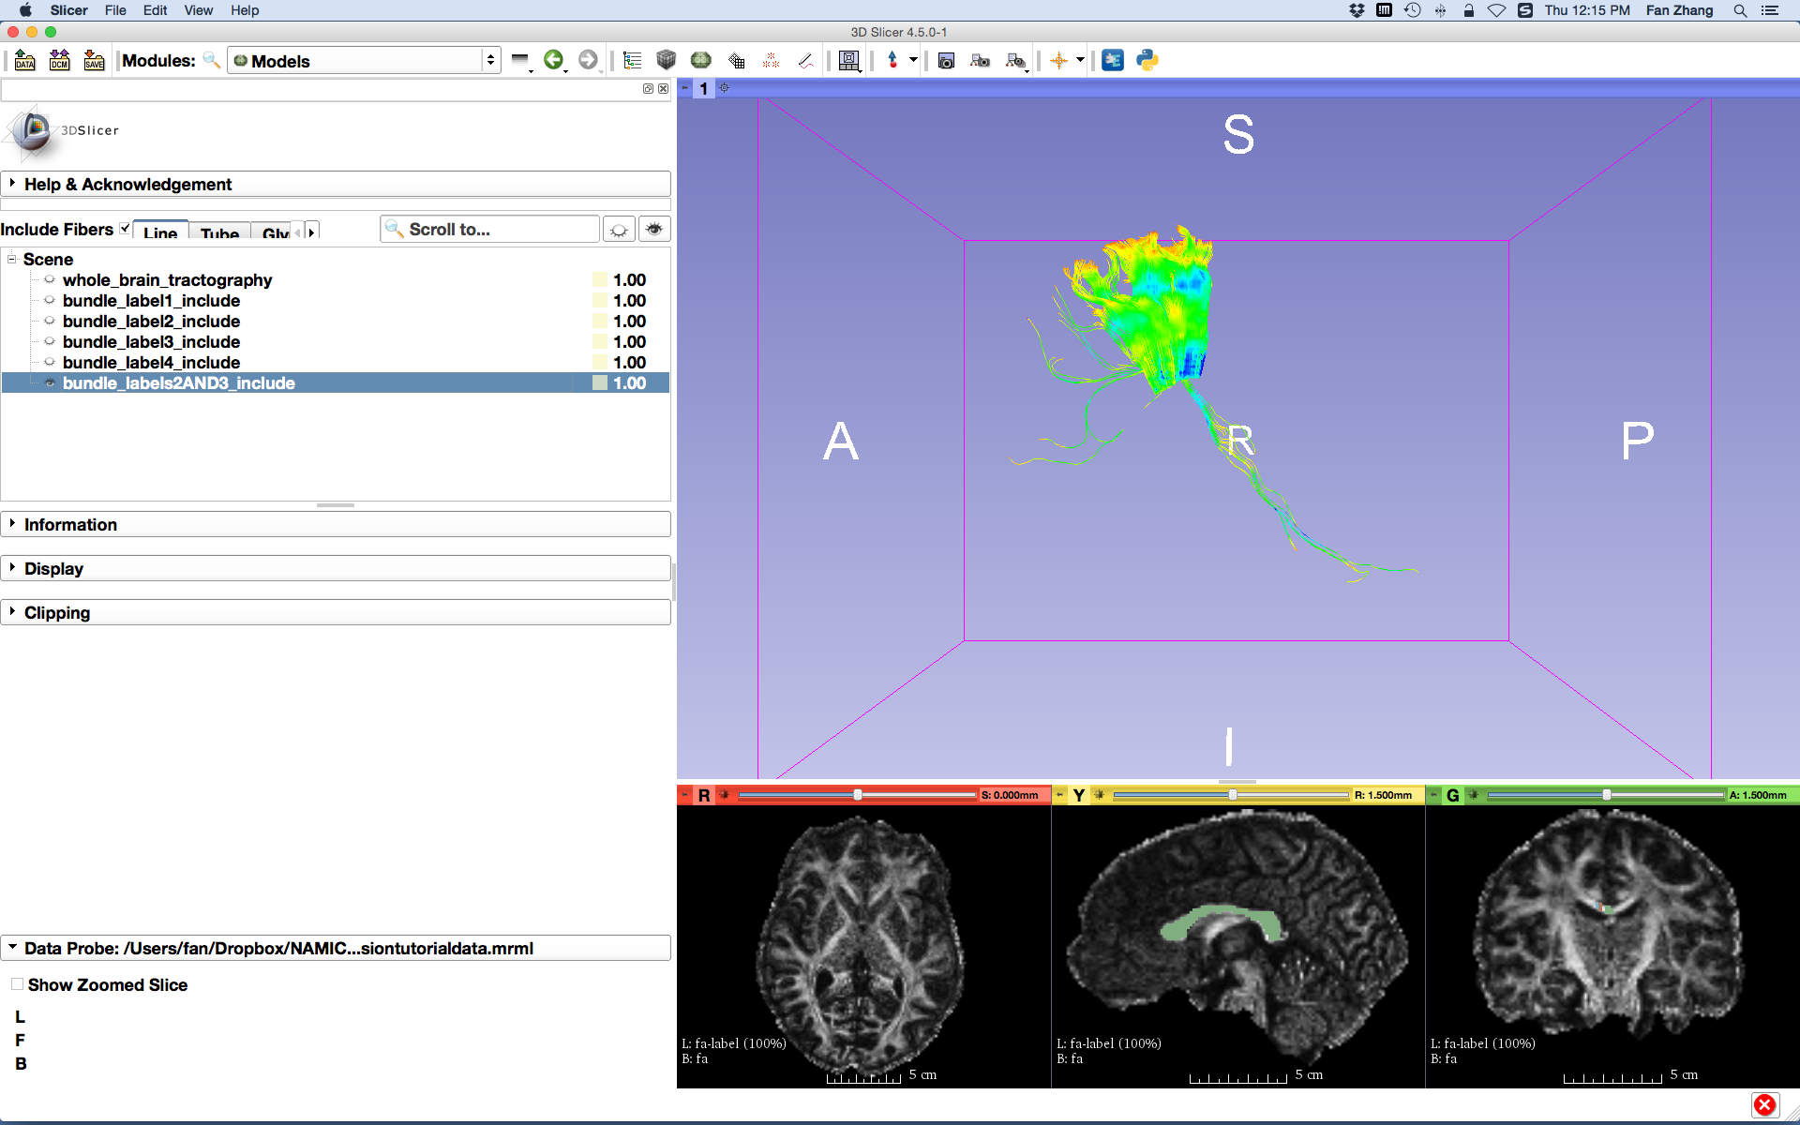
Multiple Labels Selection (AND)
The fiber bundle that passes through both labels 2 and 3 is displayed.
Notes:
We got the results that passing though both labels 2 and 3.

Slide 31
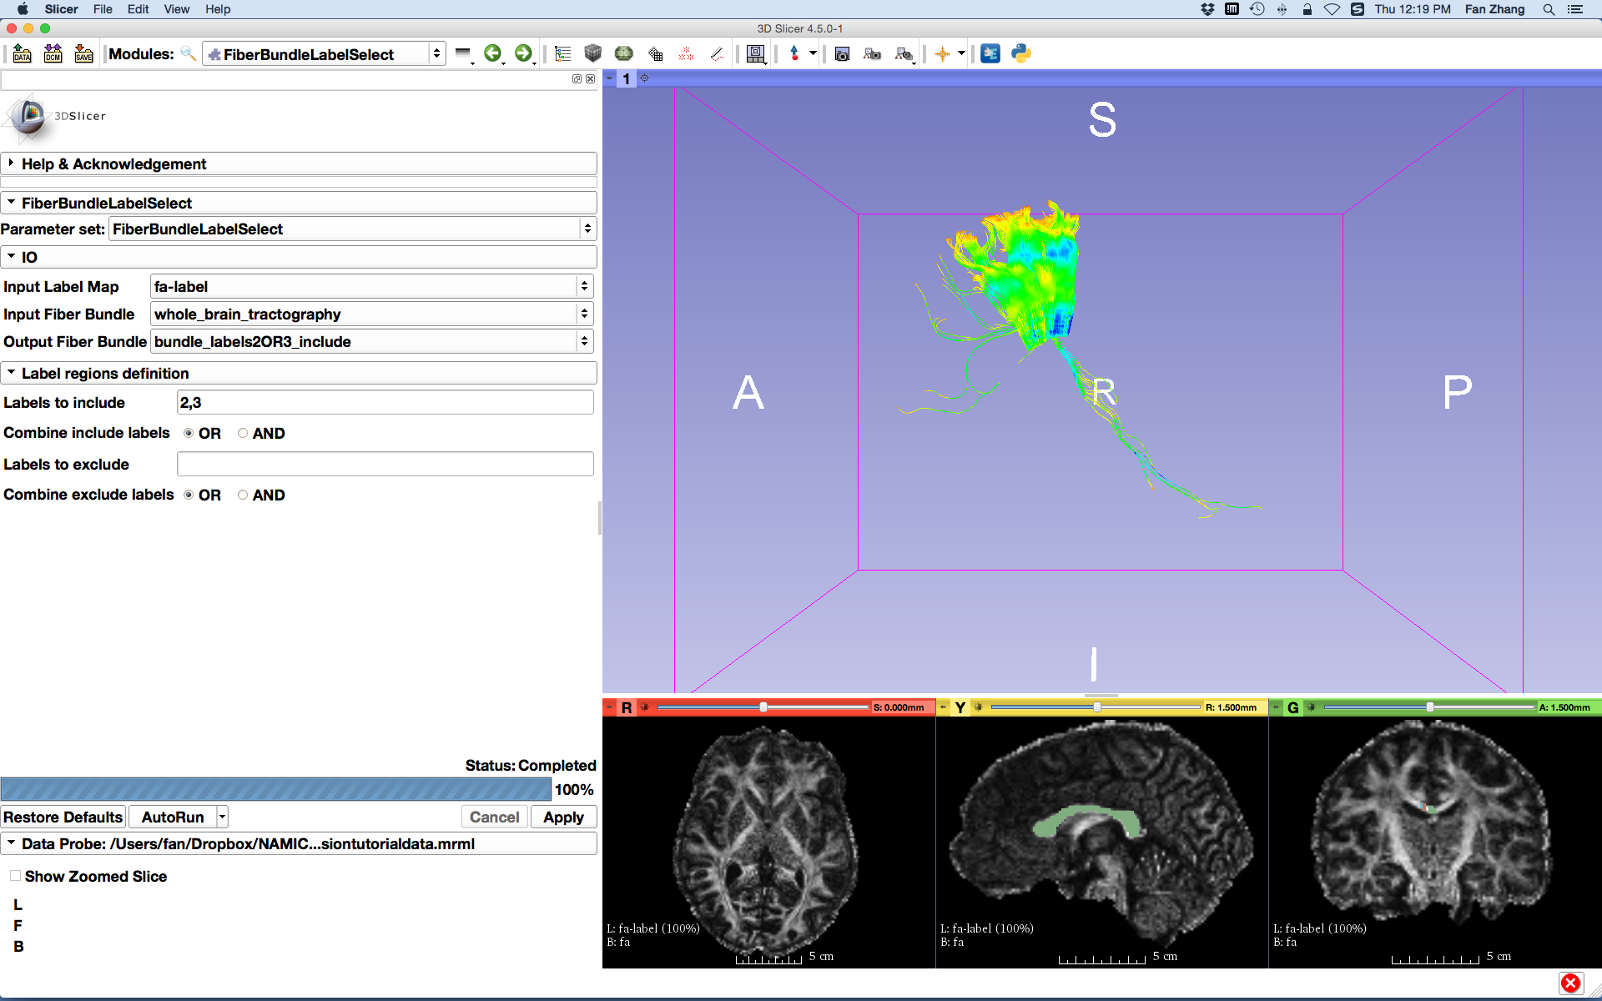
Multiple Labels Selection (OR)
Repeat the above steps to select the fiber bundle that passes through labels 2 or 3 and obtain the selection result of bundle_labels2OR3_include
Set Combine include labels to OR
Click the button Apply
Notes:
Let’s change it to OR operation. And click apply.

Slide 32
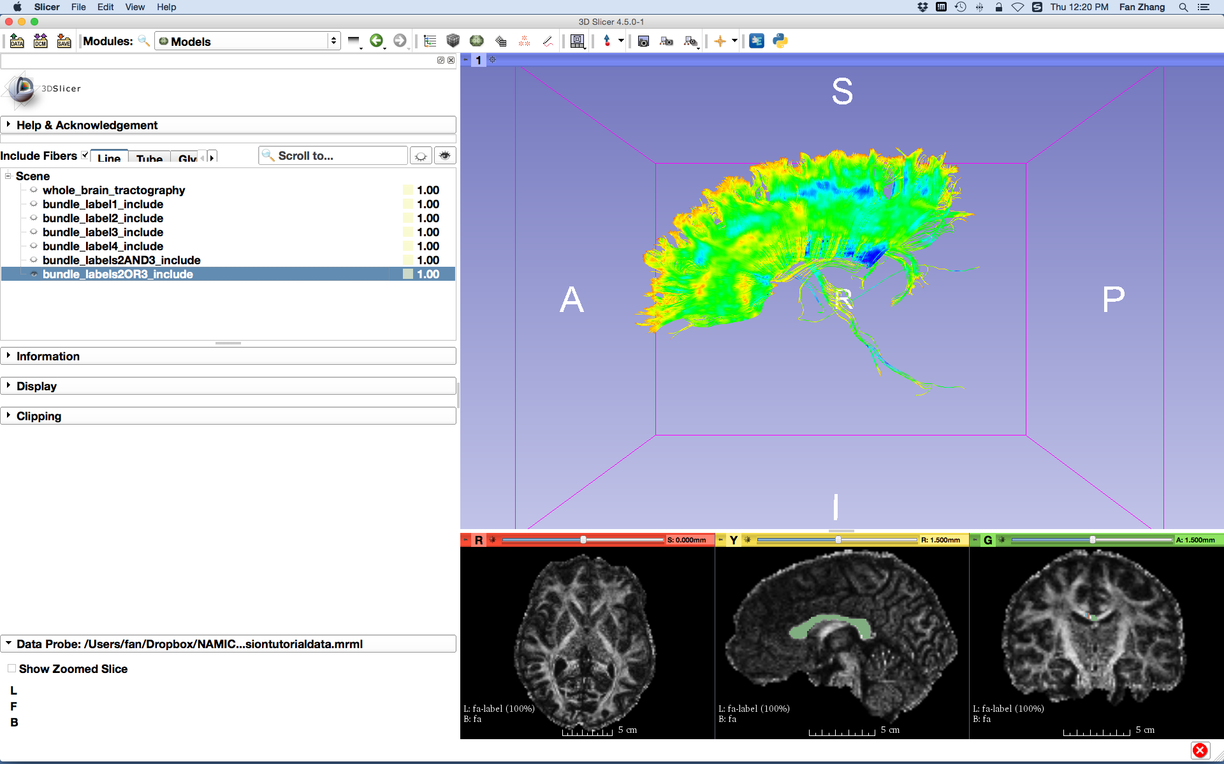
Multiple Labels Selection (OR)
The fiber bundle that passes through either labels 2 or 3 is displayed.
Notes:
Then we get the fibers that passing through either labels 2 or 3.

Slide 33
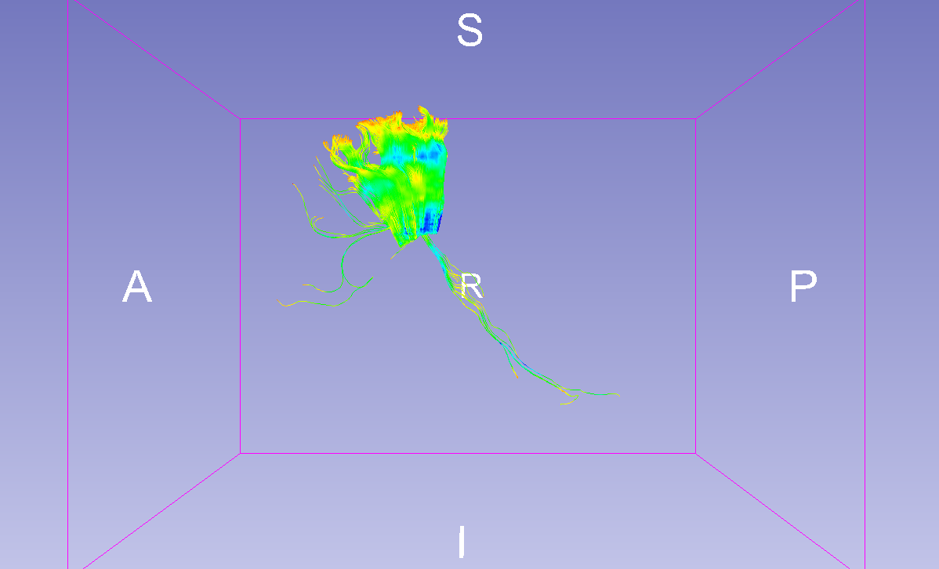
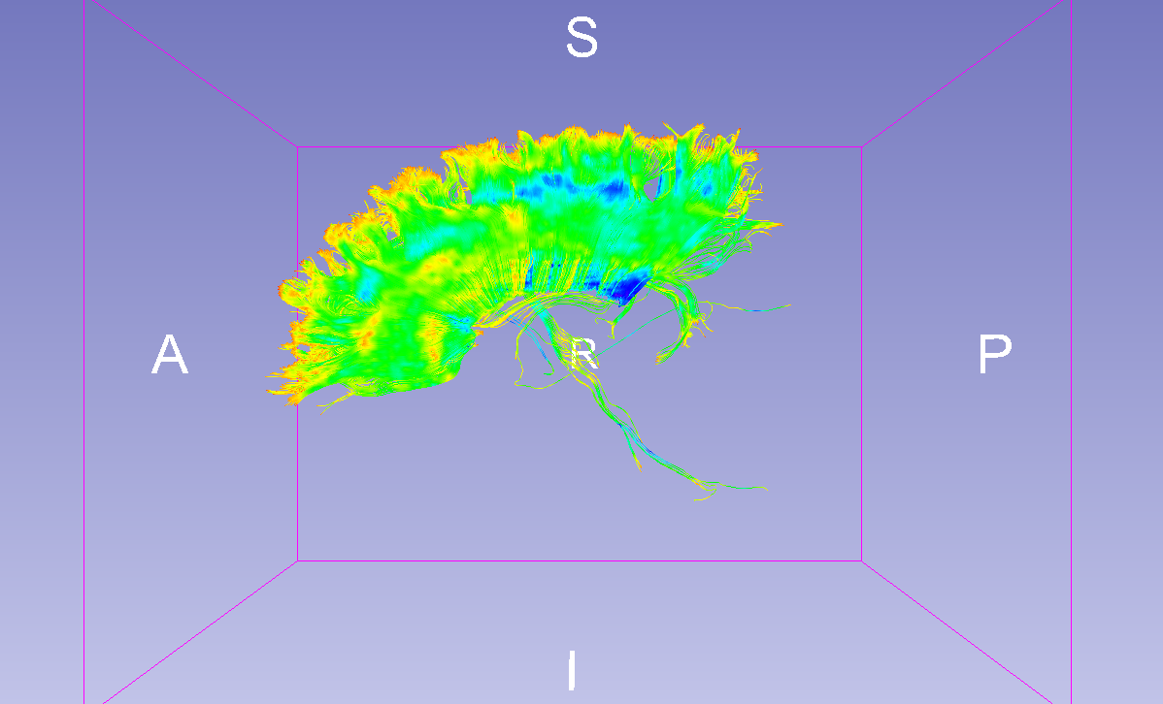
Multiple Labels Selection
Labels 2 and 3
Labels 2 or 3
Notes:
Here is the comparison between the results.

Slide 34
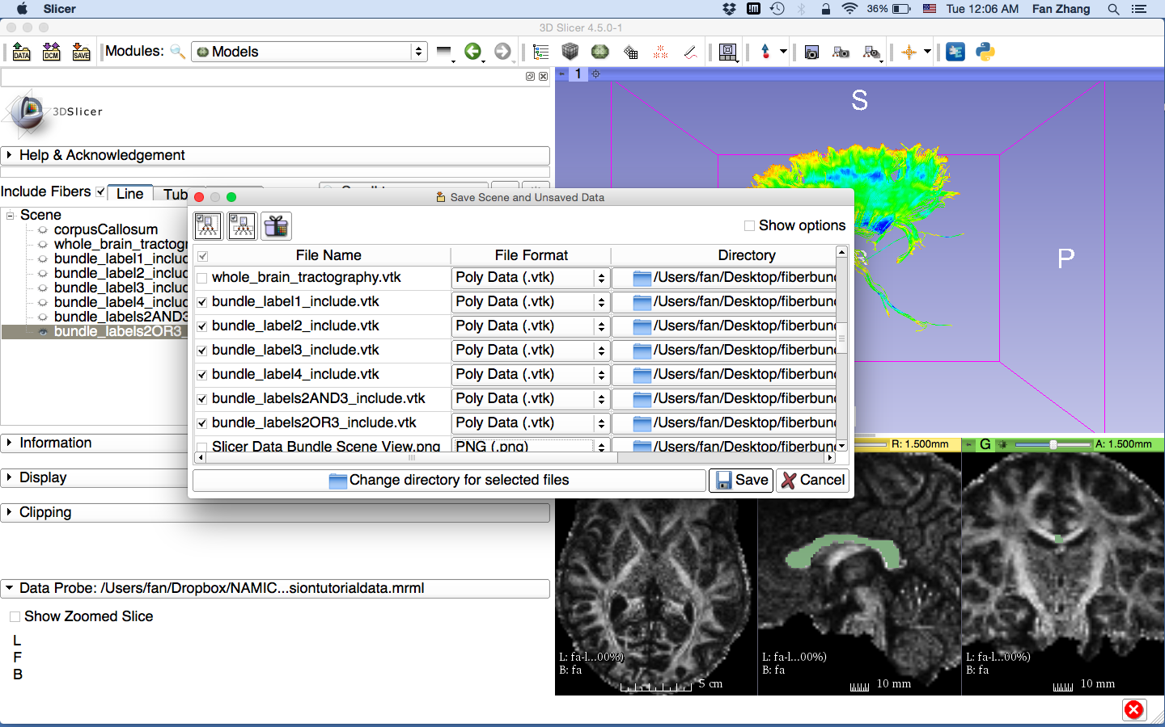
Save Fiber Bundles
Click the button SAVE
Click Change directory for selected files and select a folder to store the vtk files
Check the fiber bundles obtained above
Click the button Save
Notes:
Le’s save all fibers we just obtained and we finish the fiber bundle selection part.

Slide 35
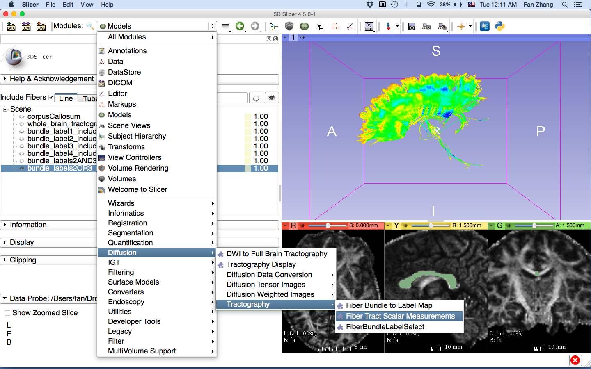
Fiber Tract Scalar Measurements
Select the module Fiber Tract Scalar Measurements
Notes:
Then let’s go to the scalar measurement part, with the module FiberTractScalarMeasurement under tractography category.

Slide 36
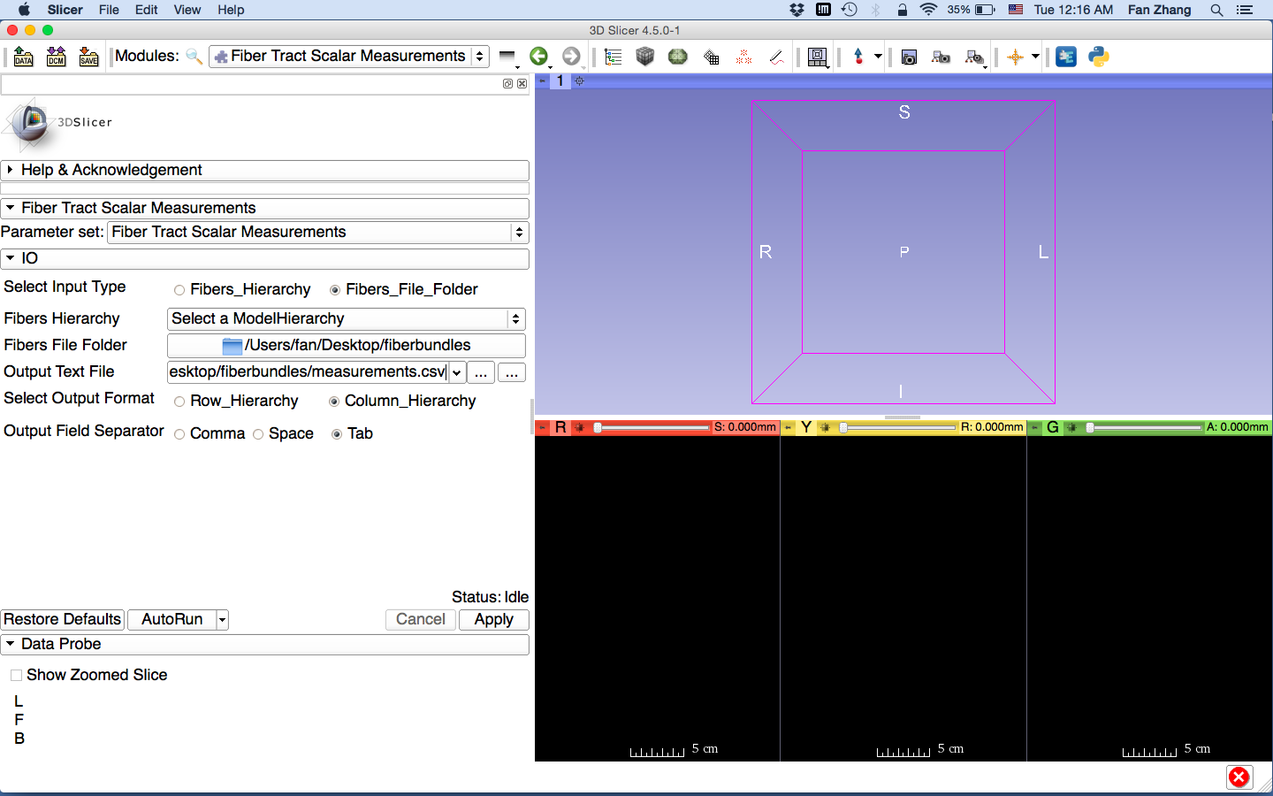
Fiber Tract Scalar Measurements
Set the FiberTractScalarMeasurements parameters:
- Select Input Type: Fibers_File_Folder
- Fibers File Folder:
XXX/fiberbundles
- Output Text File:
XXX/fiberbundles/measurements.csv
- Select Output Format: Column_Hierarchy
- Output Field Separator: Tab
Click the button Apply
Notes:
Now our goal is to calculate the measurement from the fiber bundles we just obtained.
For the parameters of this module, select Input Type as Fibers_File_Folder, set Fibers File Folder to the where we store the vtks, assign a output text file for the measurement results.

Slide 37
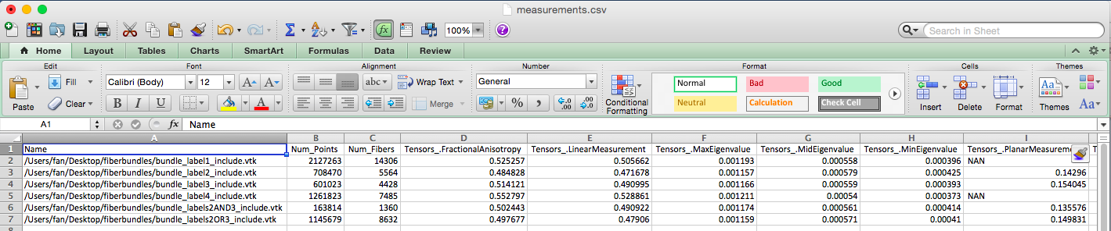
Fiber Tract Scalar Measurements
The module outputted a CSV file listing the mean scalar value (such as FA and Trace) of each fiber bundle in the folder

Slide 38
Conclusion
This tutorial guided you through the fiber bundle label selection and fiber tract scalar measurements for conducting further tractography processing.

Slide 39
Acknowledgments
The University of Sydney, APA/IPRS/ARC
International Postgraduate Research Scholarships
Australian Postgraduate Award
Australian Research Council
Open Source Diffusion MRI Technology For Brain Cancer Research
NIH U01CA199459
National Center for Image Guided Therapy (NCIGT)
NIH P41EB015898
Neuroimage Analysis Center (NAC)
NIH P41EB015902

